Slide 1
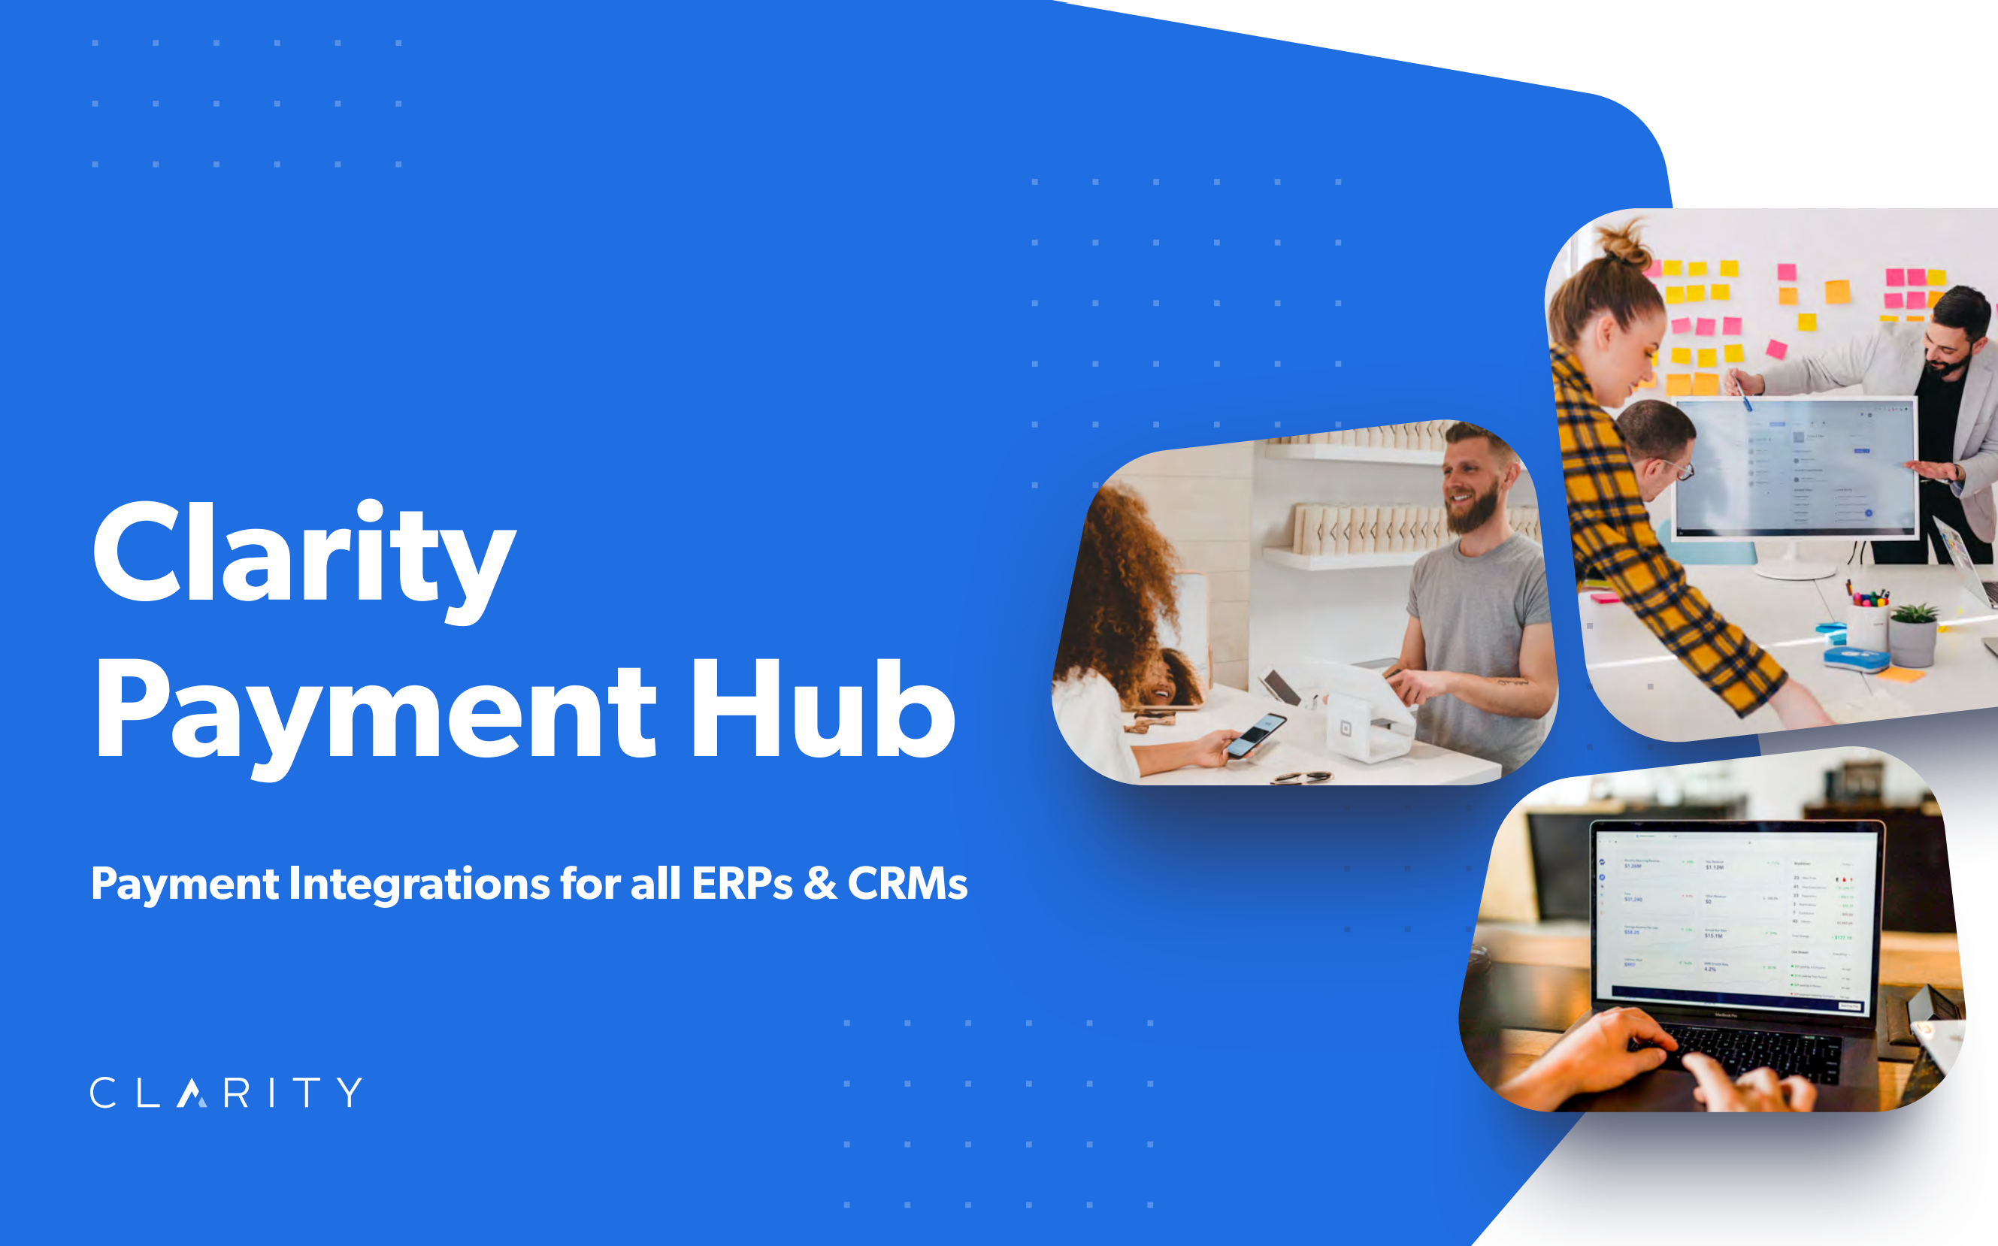

Slide 2

Agenda
Overview
System Architecture
Available Configurations
Hosting
Integrations
Portal UI
Timeline
Pricing

Slide 3





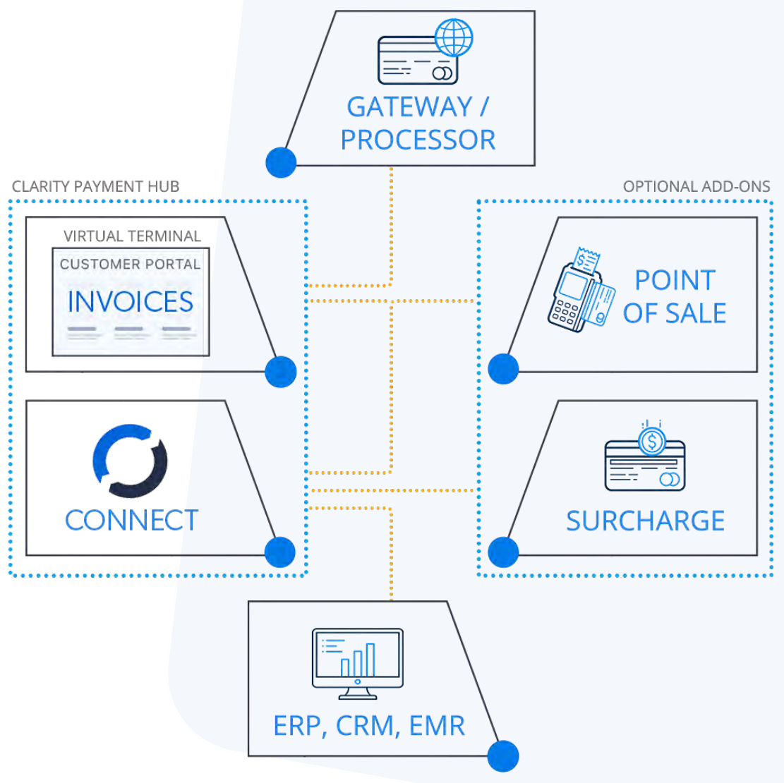
Overview
Invoice Payment Solution that can Integrate with any ERP and Payment Provider.
Includes:
  Customer Portal
  Virtual Terminal
  Clarity Connect

Slide 4
System Architecture
1. The ERP/CRM/EMR
  Your ERP/CRM/EMR will be the “Source of Truth” for all Customers and Invoices.
2. The Payment Gateway
  Must be PCI Compliant, support Tokenization, and have an accessible API.
3. Clarity Connect: The Integration Platform
  Connect is the middleware that sits between the source of truth and the Customer Portal for synchronizing Customers, Invoices, and Payments.
4. CEF: The Customer Portal/Virtual Terminal
  The Customer Portal is a simplified version of our eCommerce Platform that only includes the Account Settings and Invoice Modules from the User Dashboard.
2
4
3
1

Slide 5
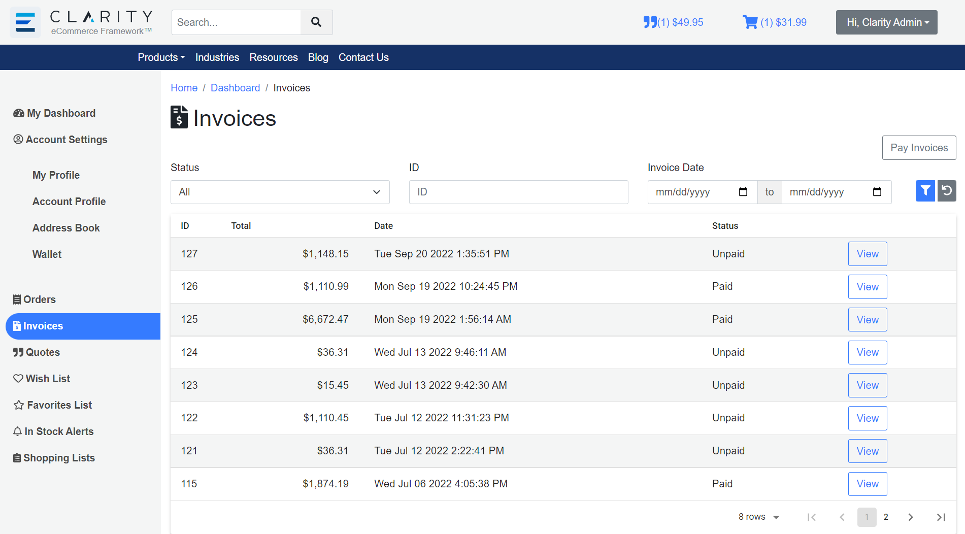

Slide 6
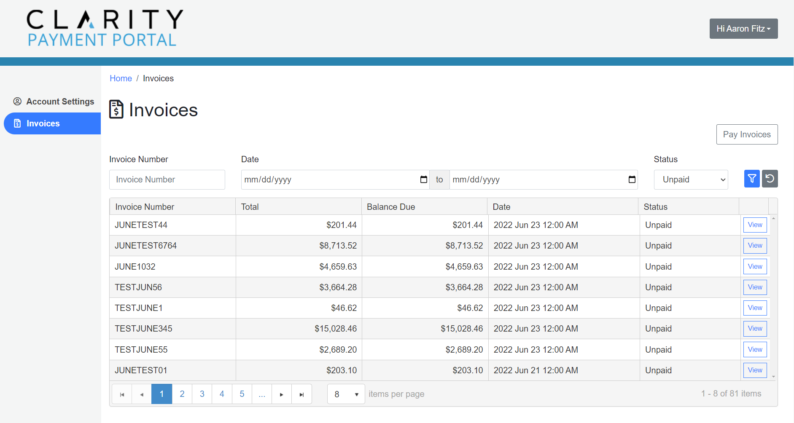

Slide 7
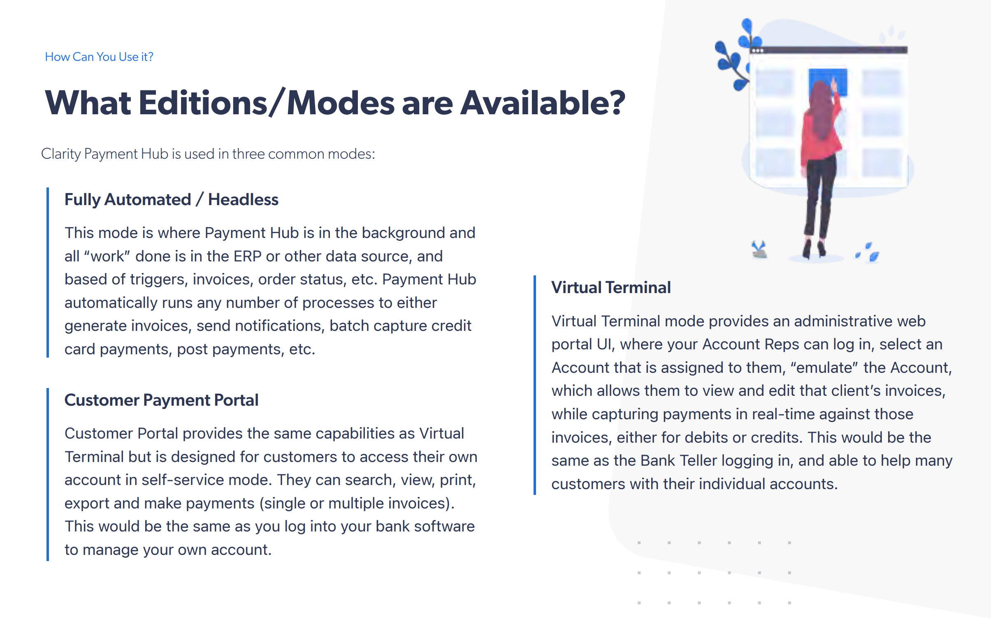

Slide 8
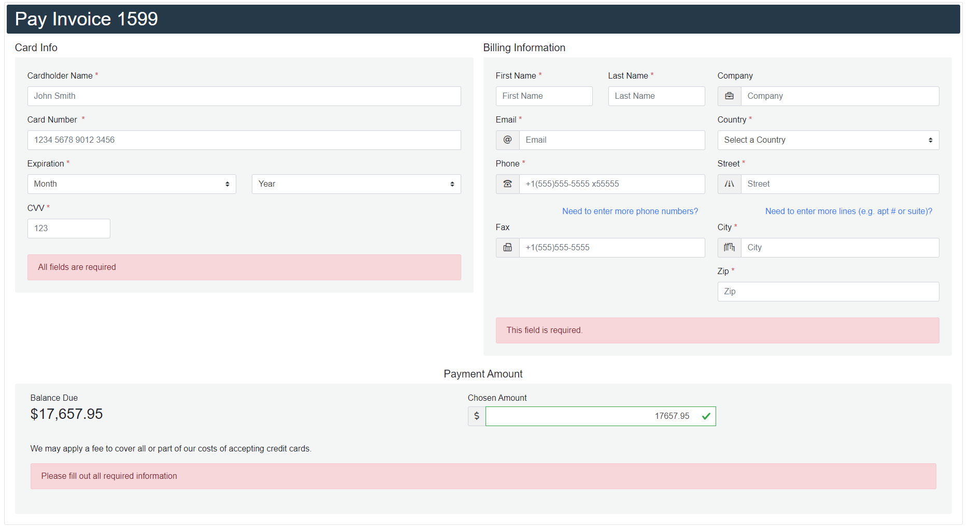

Slide 9
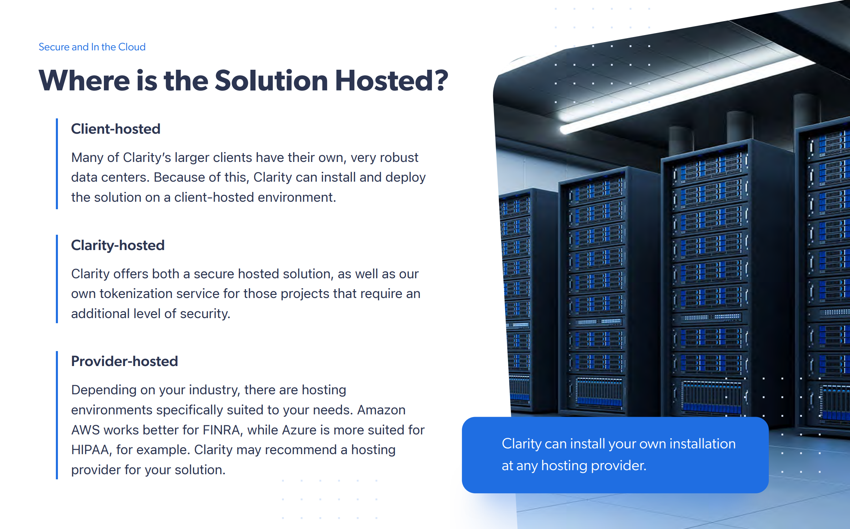
*Included with SaaS Pricing

Slide 10
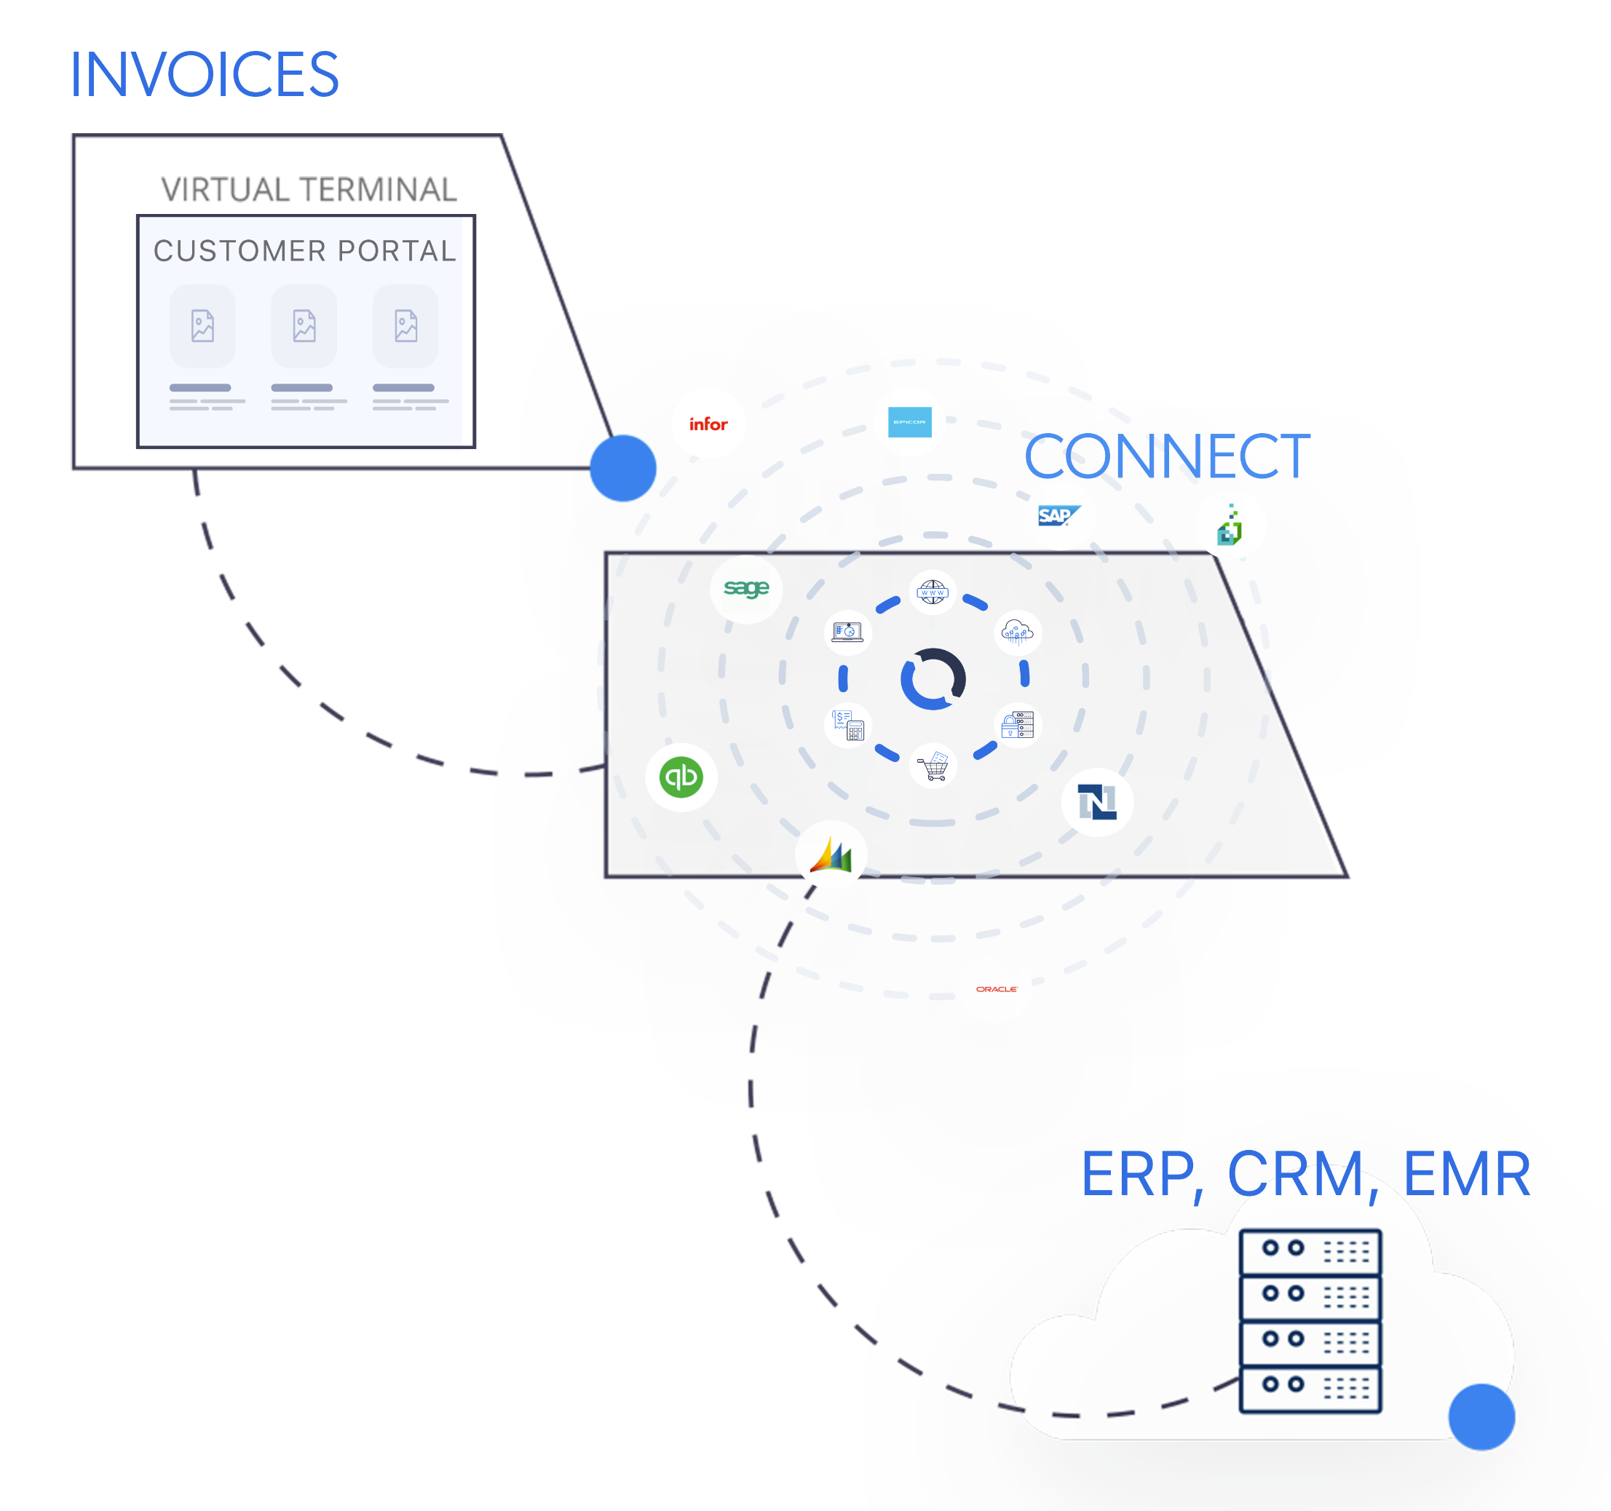
Integrations
  Connect is the middleware that sits between the Customer Portal and the Source of Truth for synchronizing Customers, Invoices, and Payments.
To PayHub:
  Accounts (Customers/Companies)
  Users (Contacts/Individuals)
  Addresses (Optional)
  Invoices (Create/Update)
From PayHub
  Invoices (Update)
  Payment Details

Slide 11
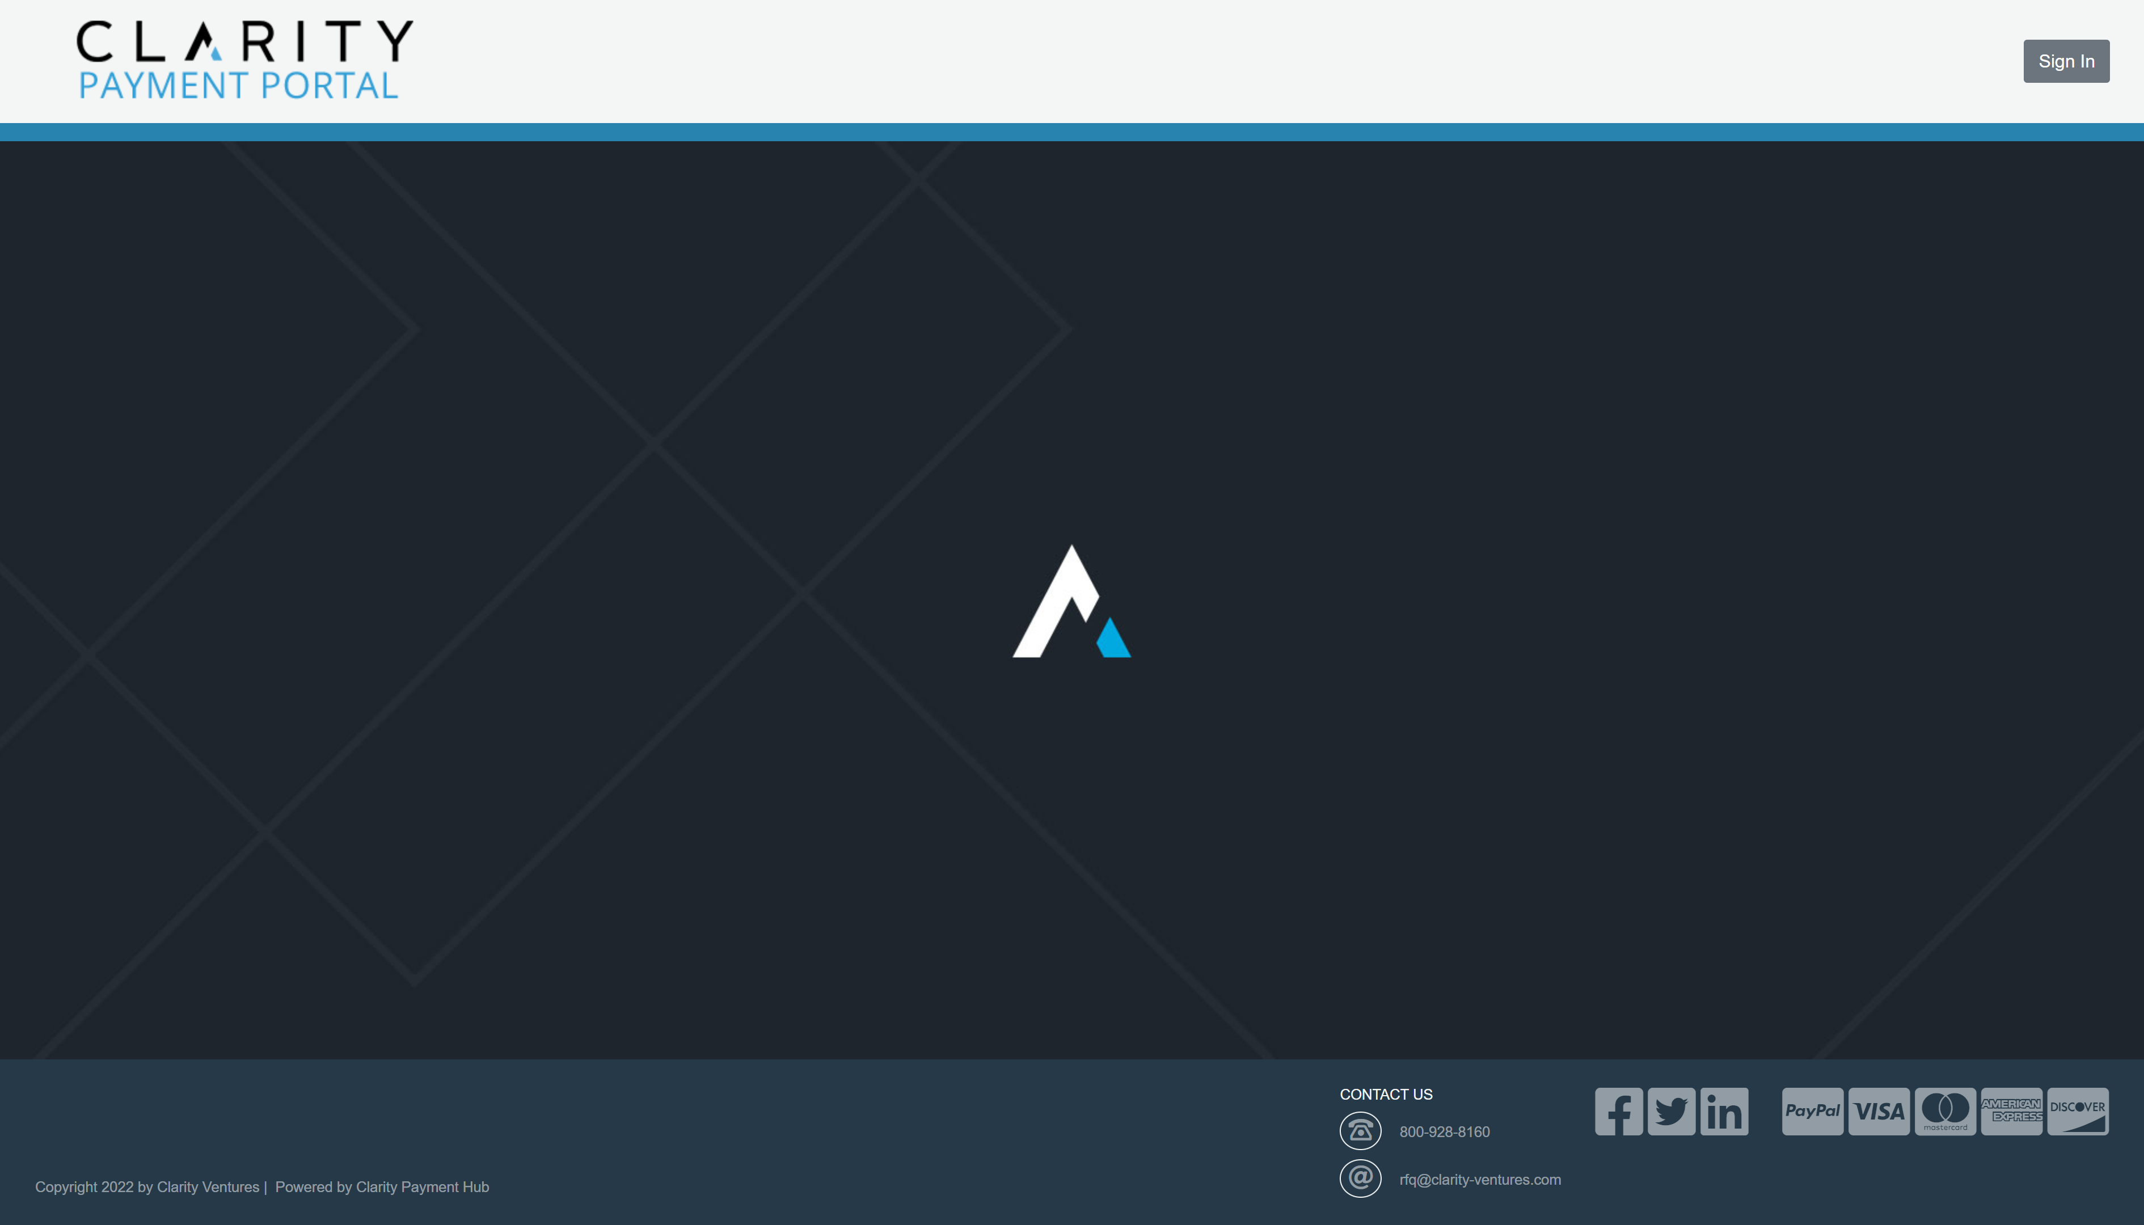

Slide 12
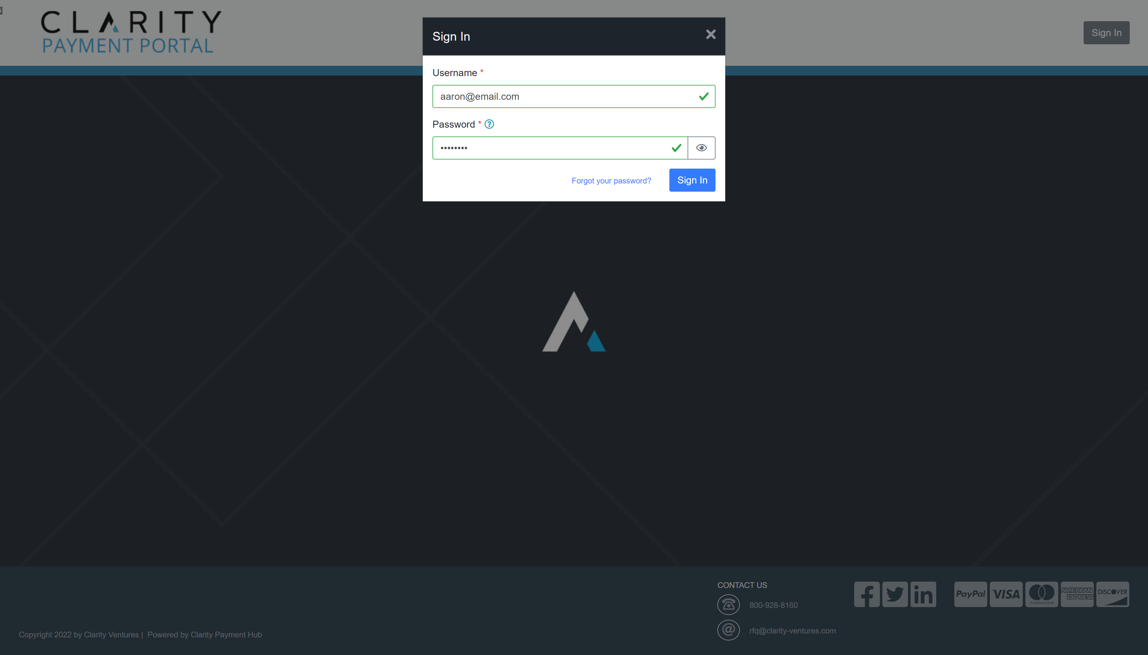

Slide 13
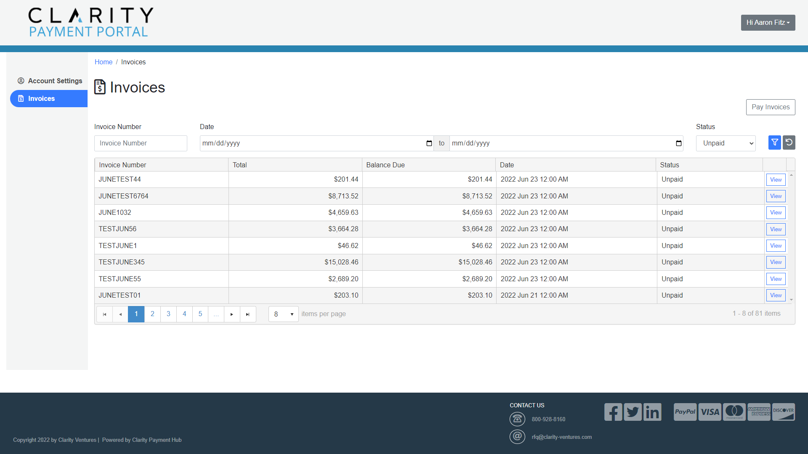

Slide 14
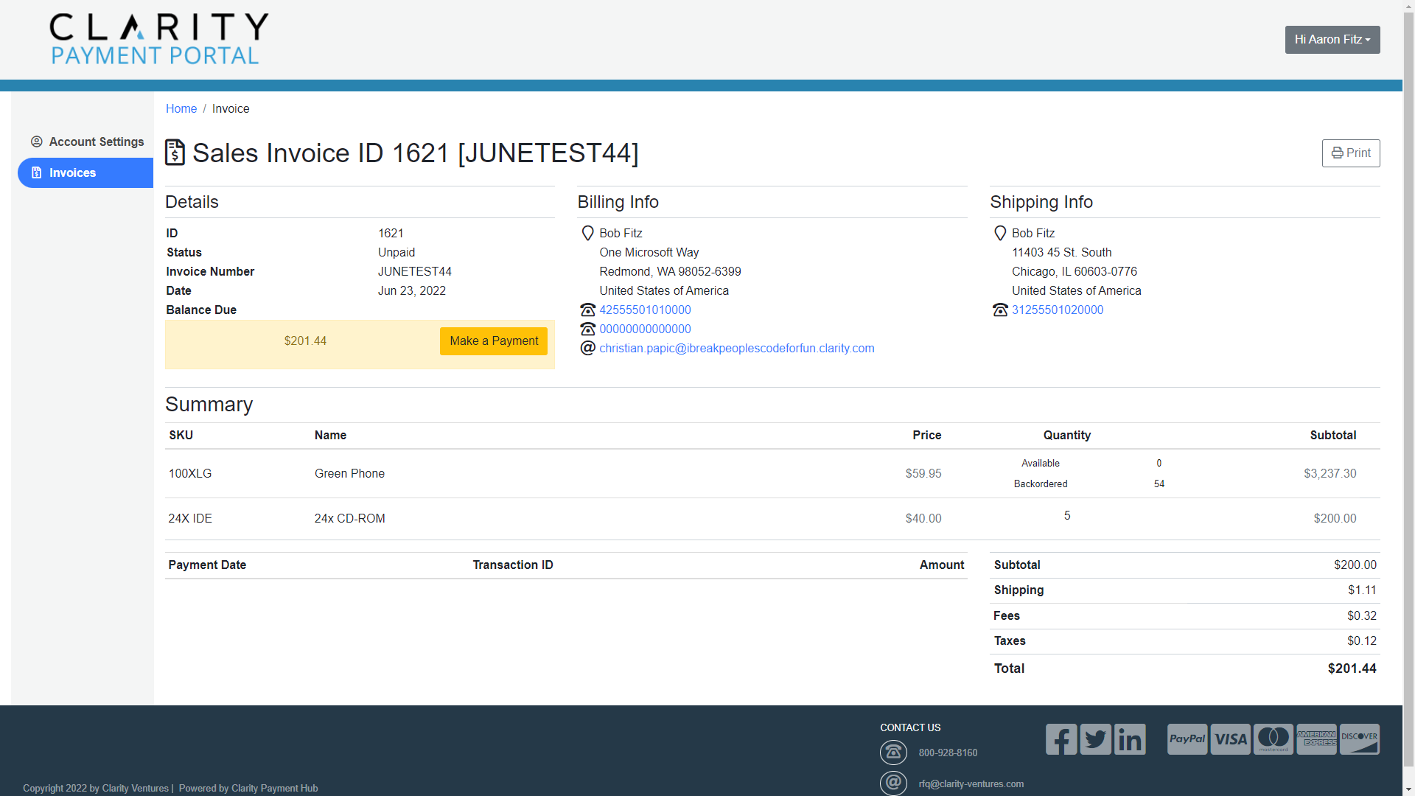

Slide 15
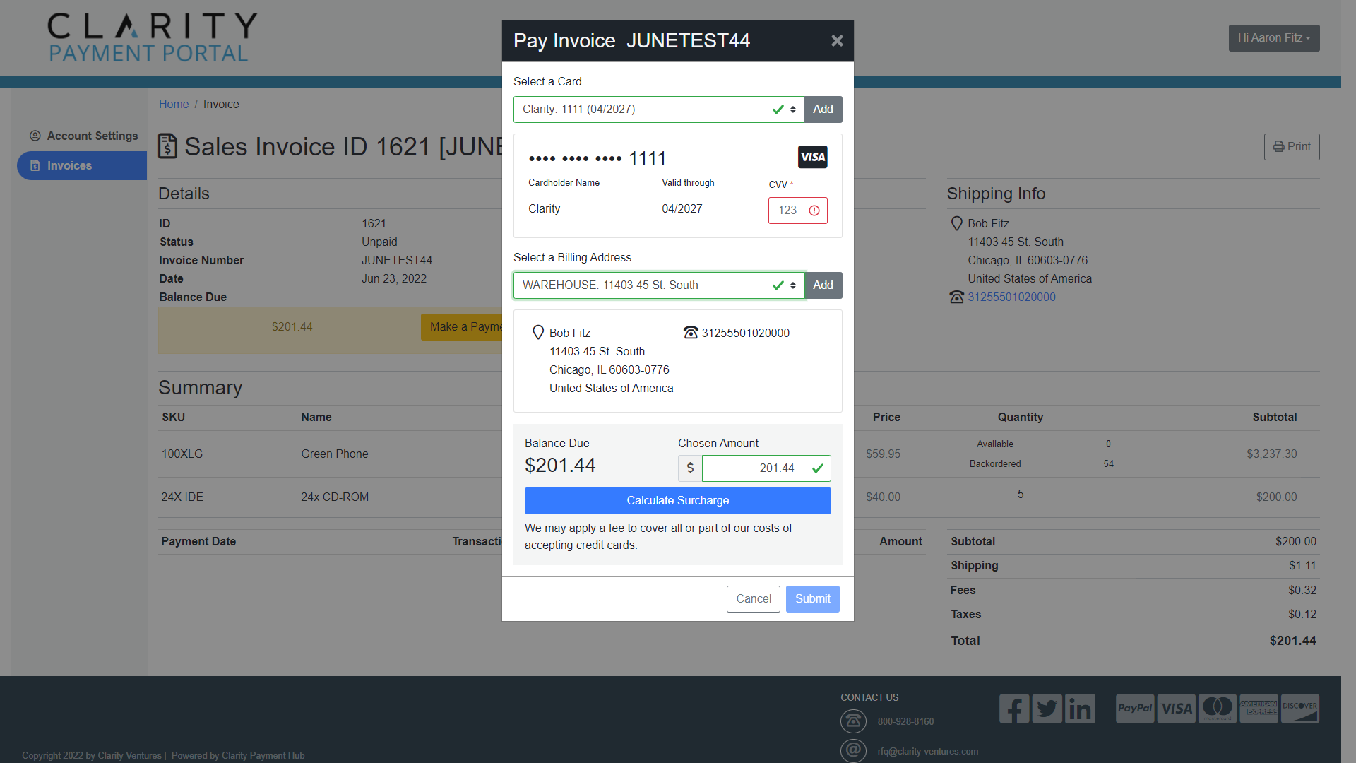

Slide 16
The Payment Gateway
Payment Hub integrates directly with your Payment Gateway to generate a token when a card is saved to the wallet which ensures that we retain PCI Compliance and never store any card information within the system.
When a payment is made, Payment Hub uses the Credit Card Token to authorize the transaction and/or capture payment.
Gateway/Processor Requirements:
  Must be PCI Compliant
  Must support Tokenization
  Must have an accessible API.

Slide 17
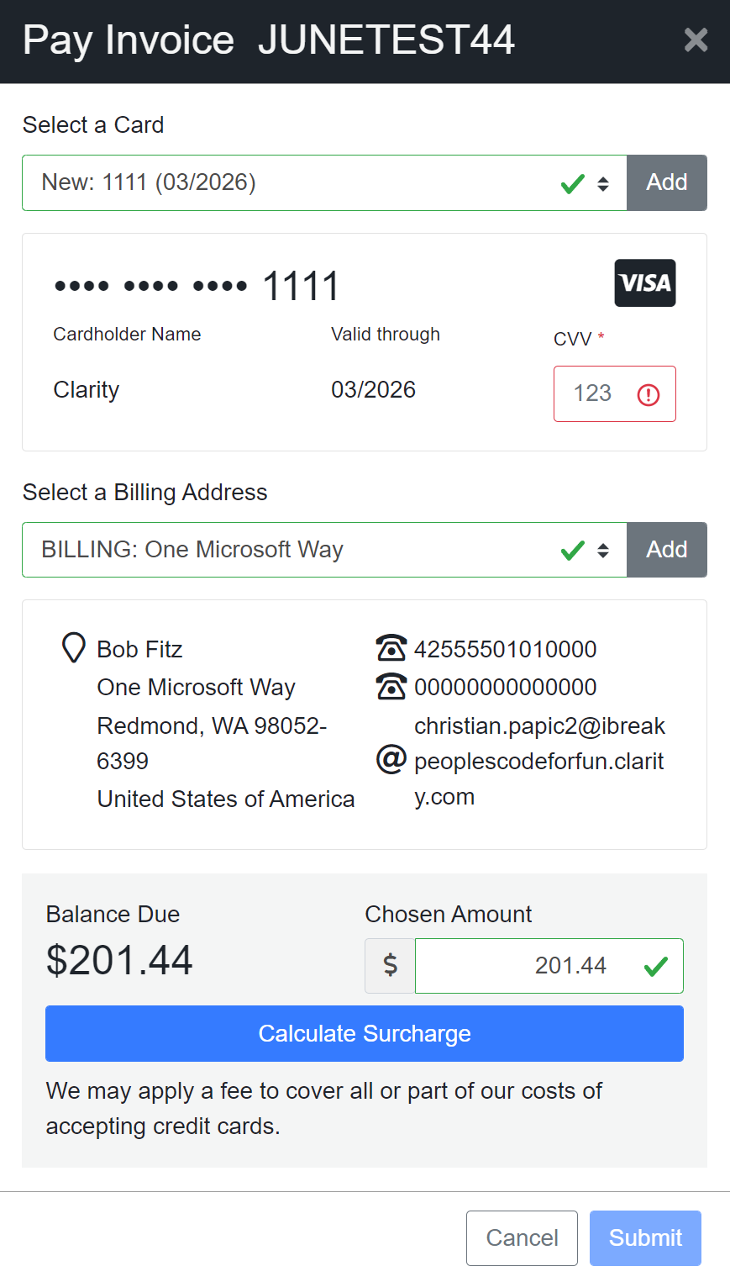
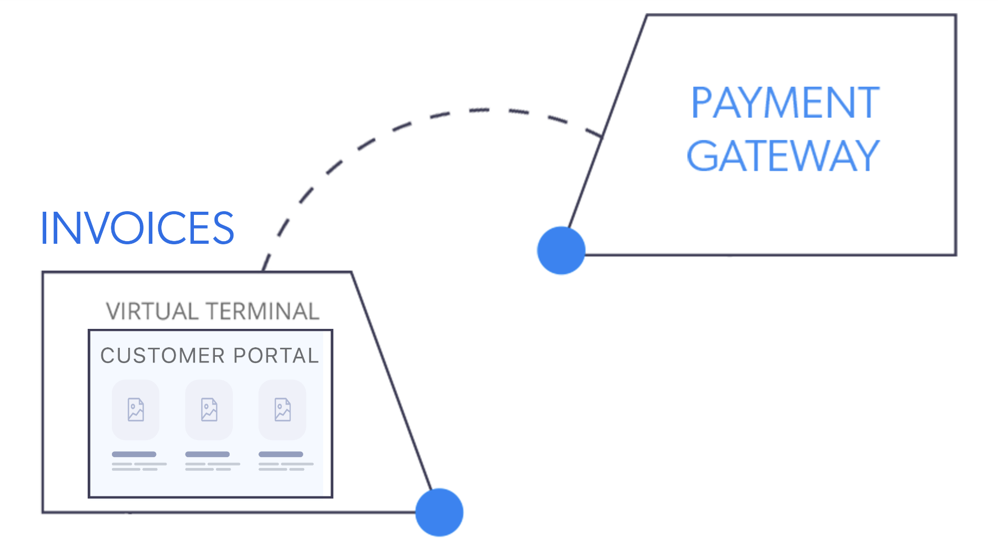
Full Individual Payments
By default, “Balance Due” automatically prepopulates into the “Chosen Amount” field.

Slide 18
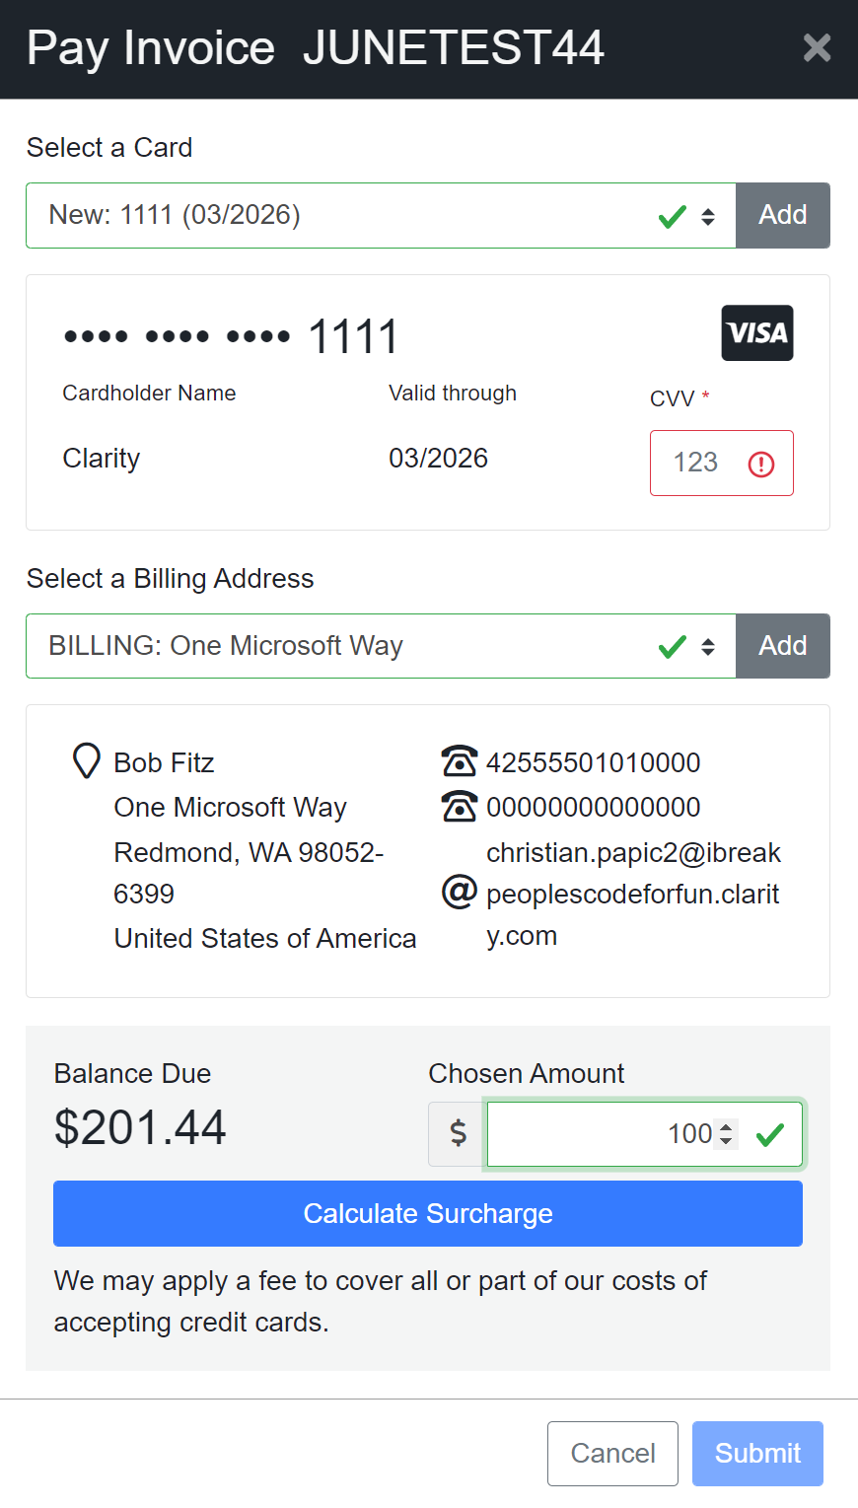
Partial Payments
The User can reduce their payment amount to below the Balance Due.
Partial Payments can be turned off upon request which makes the Chosen Amount Field ReadOnly and forces the Customer/CSR to pay the full balance due.

Slide 19
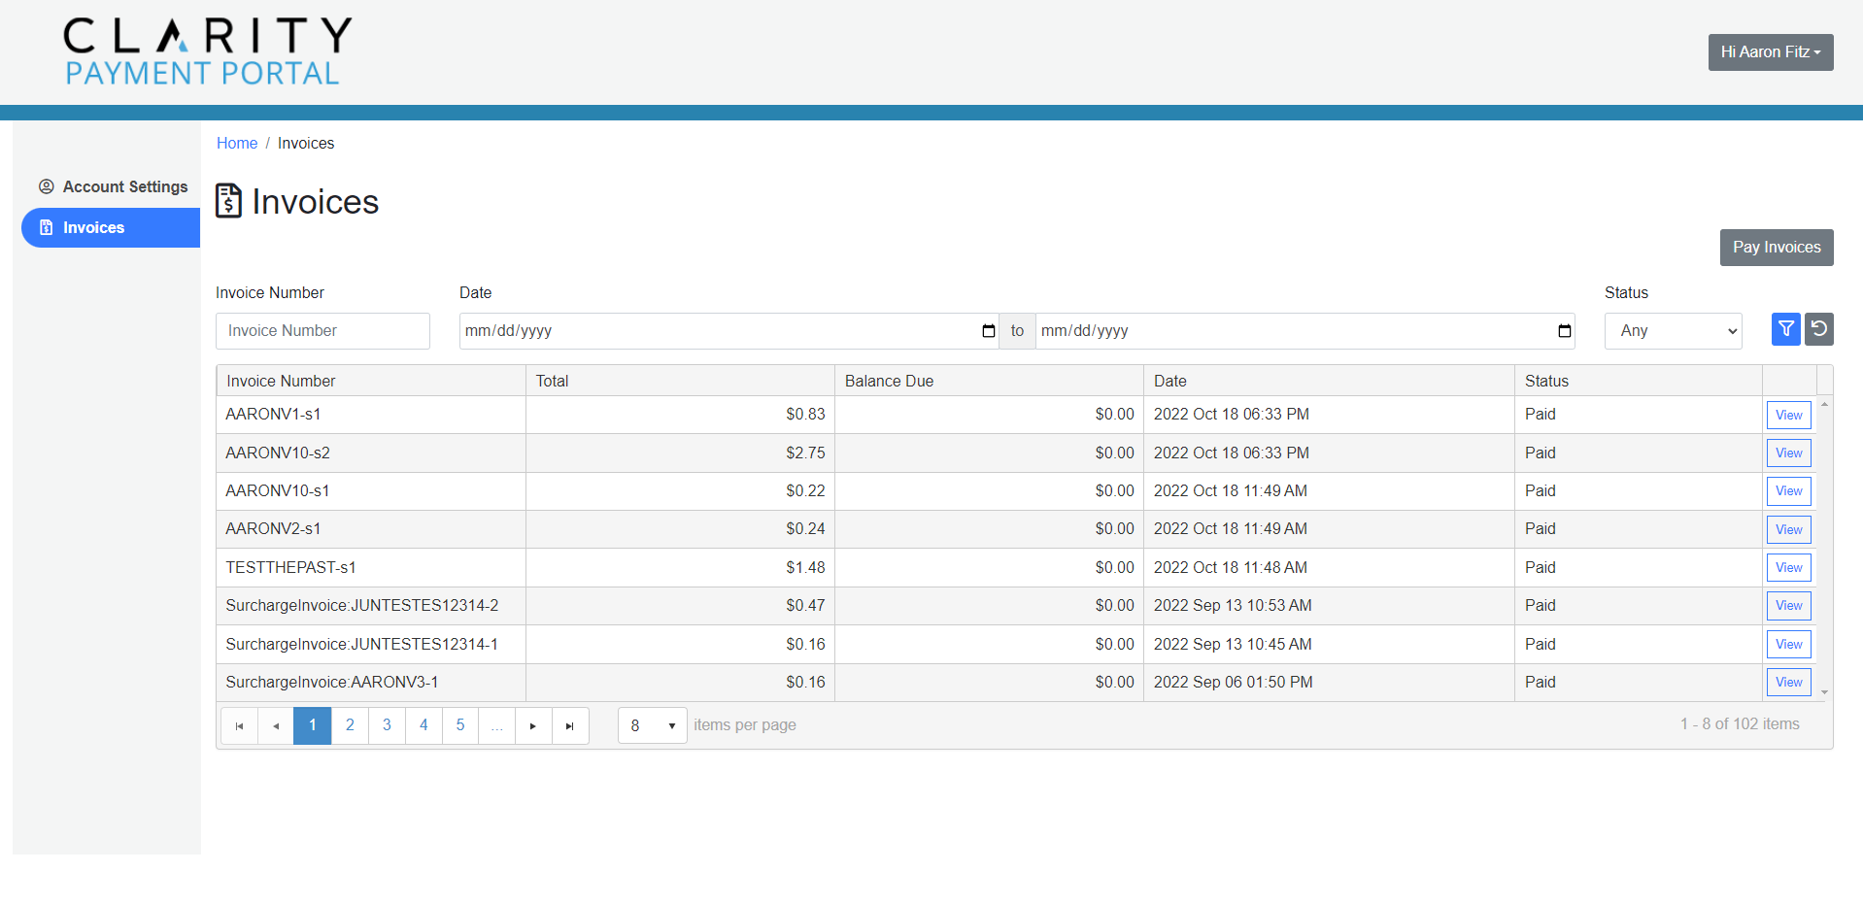
Bulk Payments

Slide 20
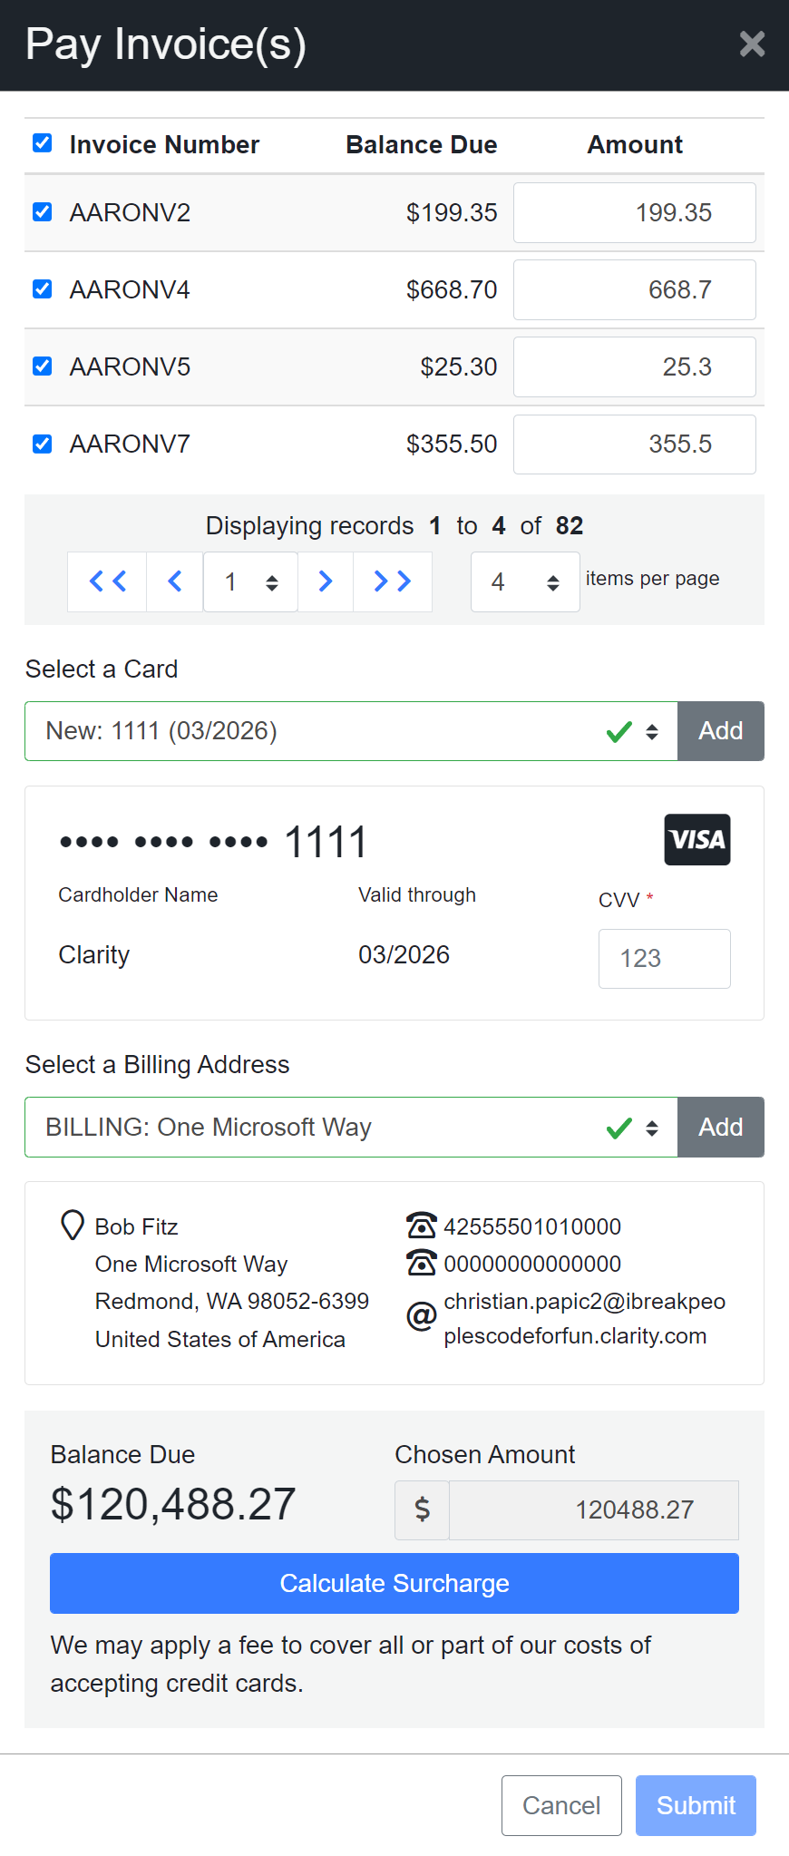
Bulk Payments
The Bulk Payment Feature shows all Unpaid Invoices, allows the User to select which Invoices they want to pay, and specify their Payment Amount. (if Partial Payments enabled)
Submits a single payment that covers all selected Invoices.
Bulk Payments can be turned off upon request.

Slide 21
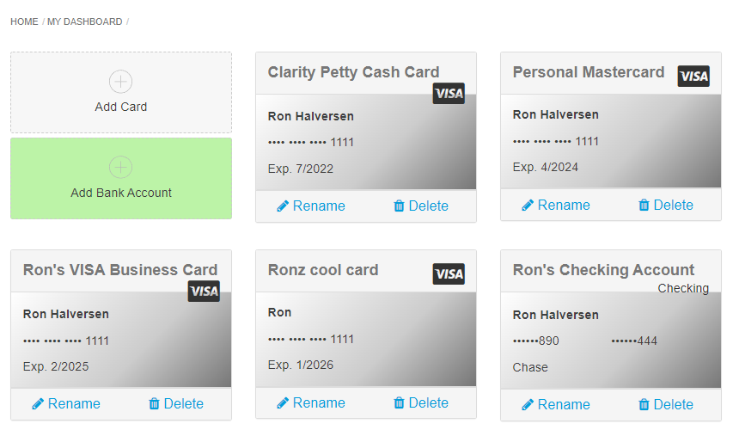
ACH Payments
ACH/eCheck can be configured to allow Customers and CSRs to add Bank Accounts to the Wallet.
The use of ACH/eCheck Payment Methods are depended on the capabilities of your PCI Provider/Payment Gateway.

Slide 22



Clarity Payment Processing
  Included with the platform
  Credit Card and ACH (North America)
  Global Credit Card processing
  *Some countries require custom EFT for wire transfers.
Benefits:
  FREE competitive rate. (Meet or beat your current Merchant Account Fee)
  FREE Merchant Account (Credit Card & ACH)
  10% Cash Back for ongoing Support or Enhancements
  (10% of all fees collected are credited to your account as available hours).

Slide 23
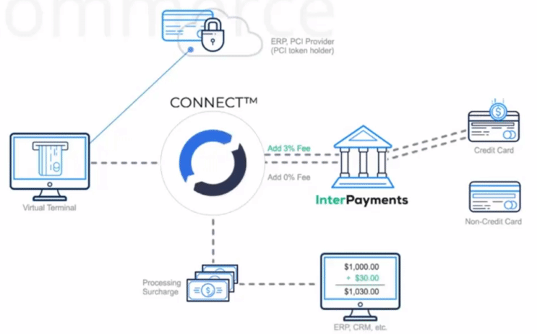
Surcharging
PayHub will receive the Credit Card’s “BIN” from the PCI/Payment Provider.
Connect will pass the BIN to the Surcharge Provider to calculate the Surcharge.
The Surcharge Amount is then applied to the Customer’s Payment Total as a fee.

Slide 24
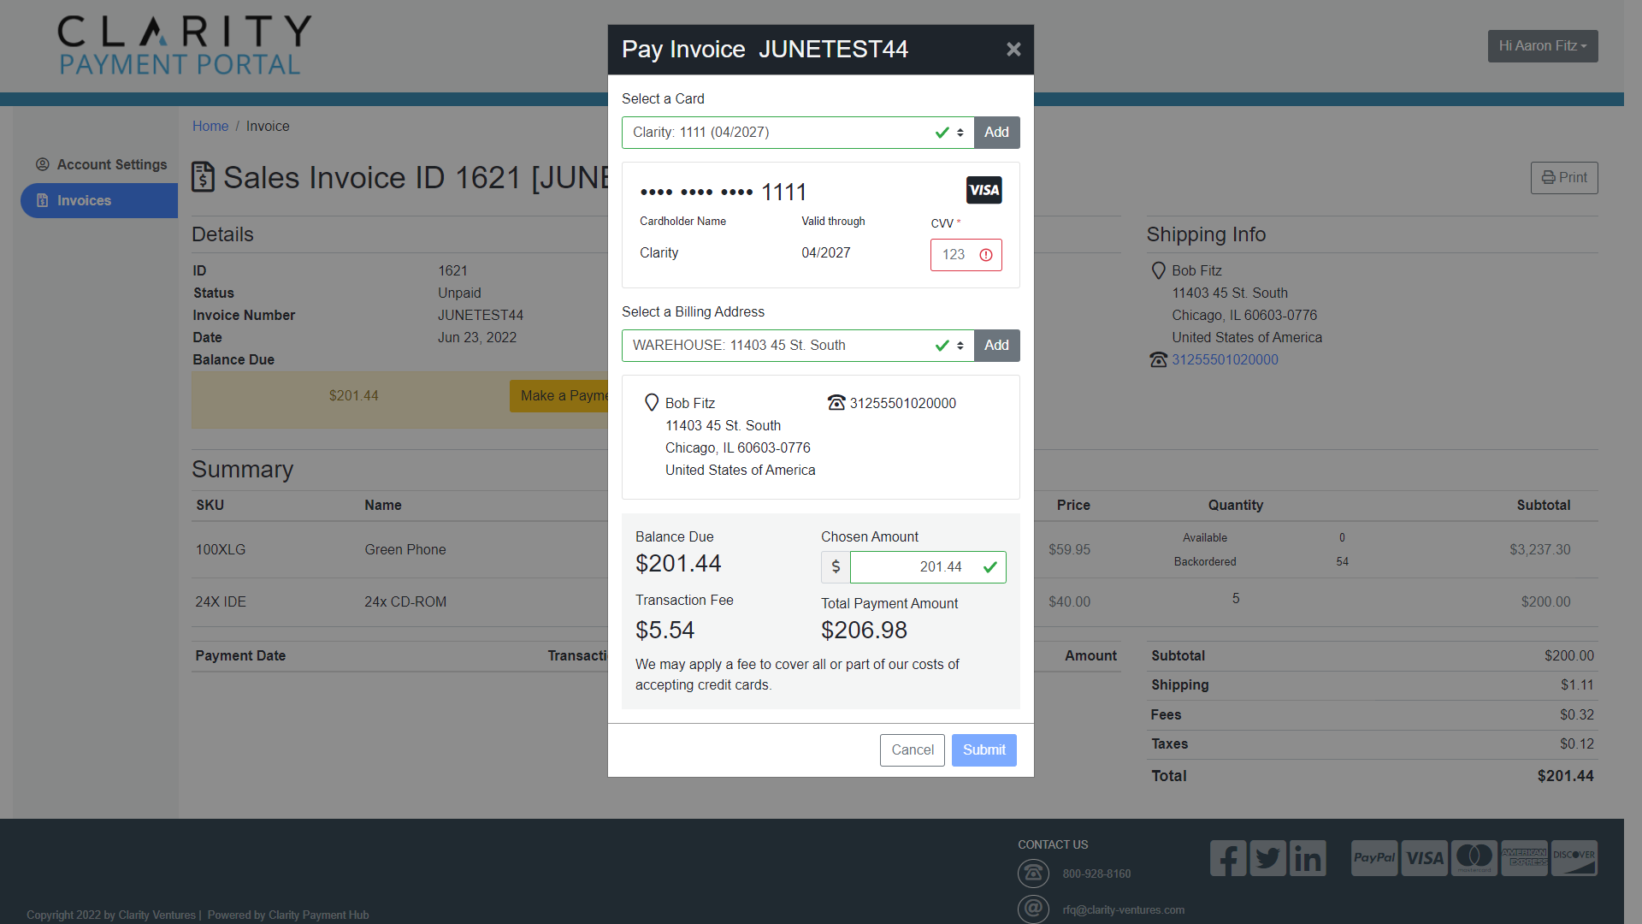

Slide 25
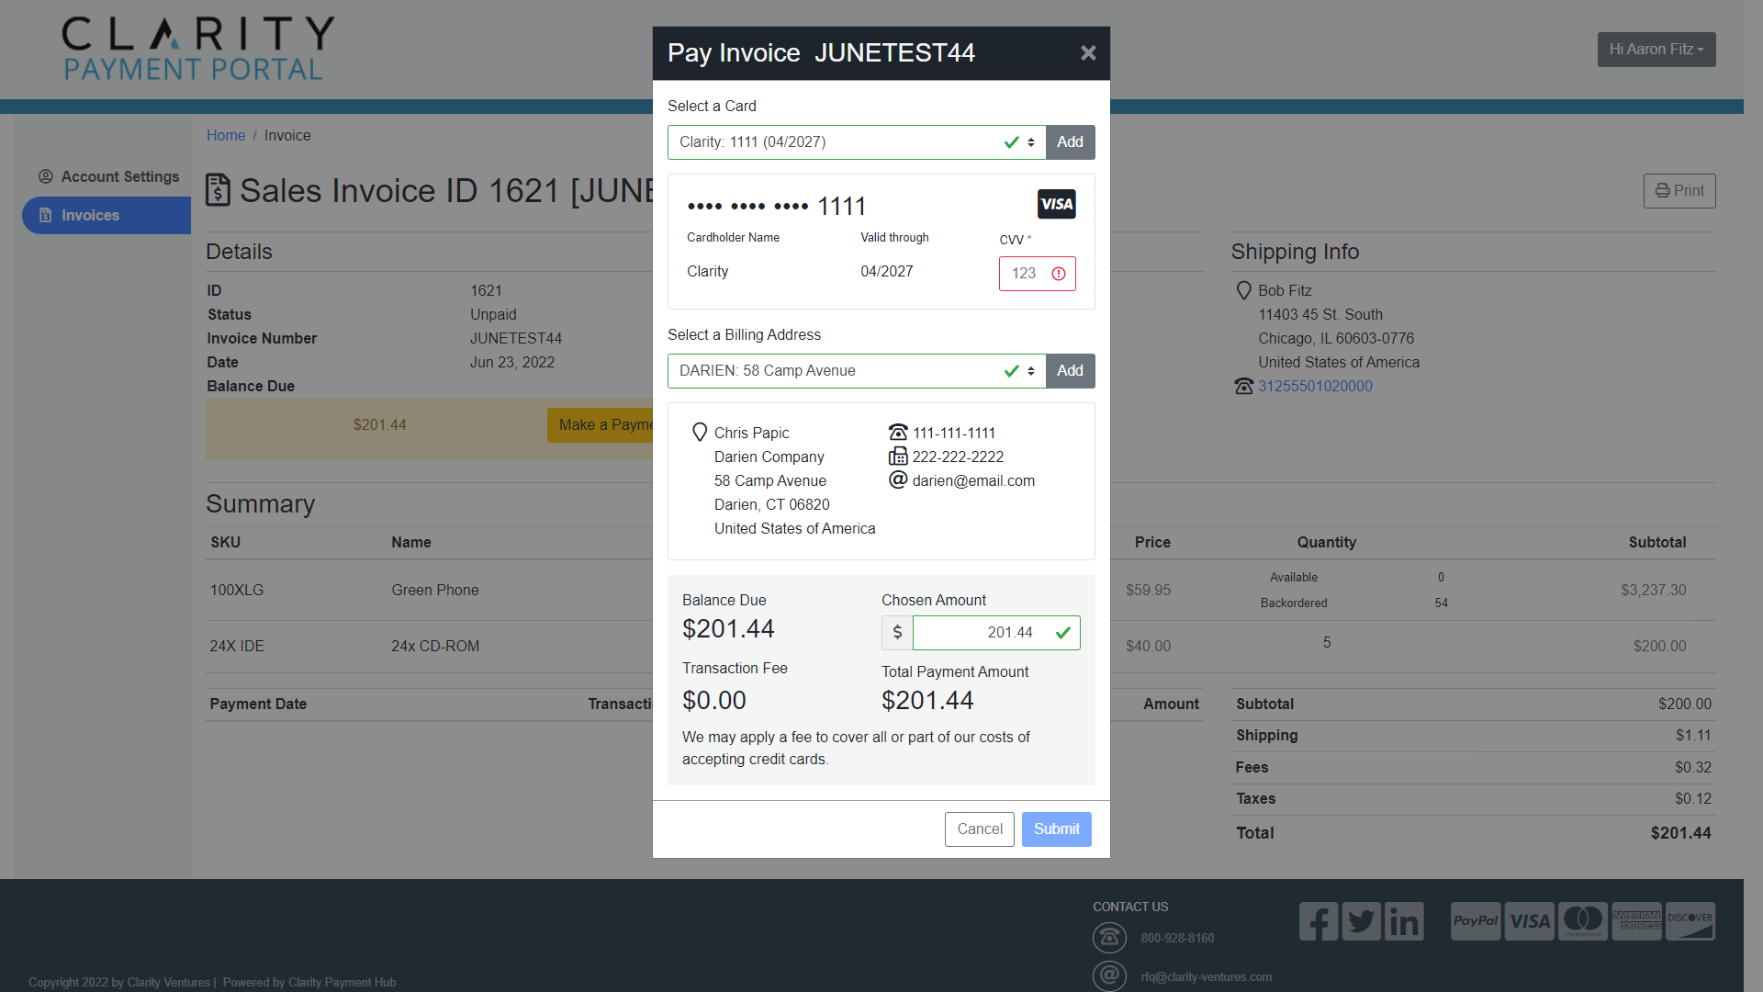

Slide 26
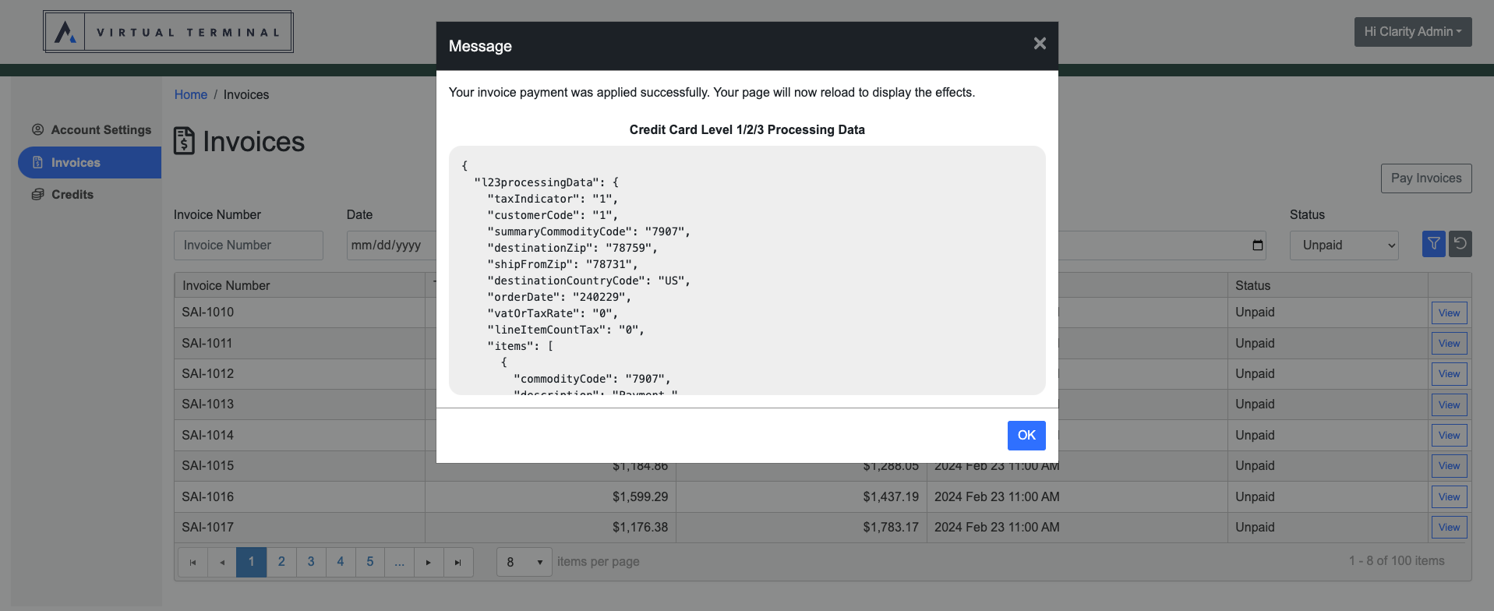
Level II & III Processing

Slide 27
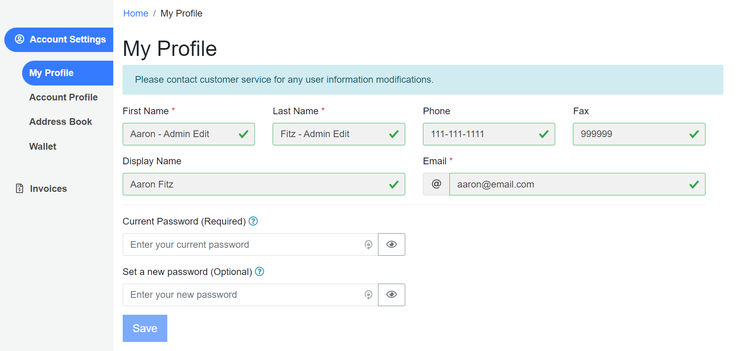
My Profile
My Profile - Displays information associated to the End User who is logged into the system including First Name, Last Name, Phone, Email (ReadOnly)

Slide 28
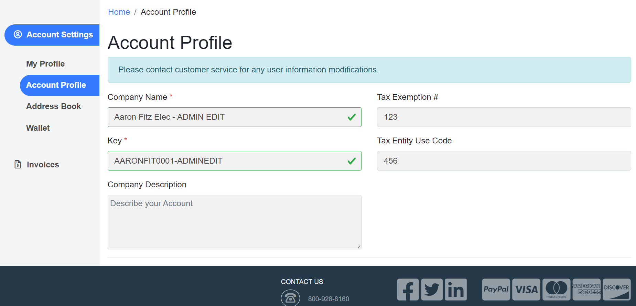
Account Profile
Displays information associated with Company such as the Company Name, Account Key/Number, Tax Exemption Number, etc. (ReadOnly)

Slide 29
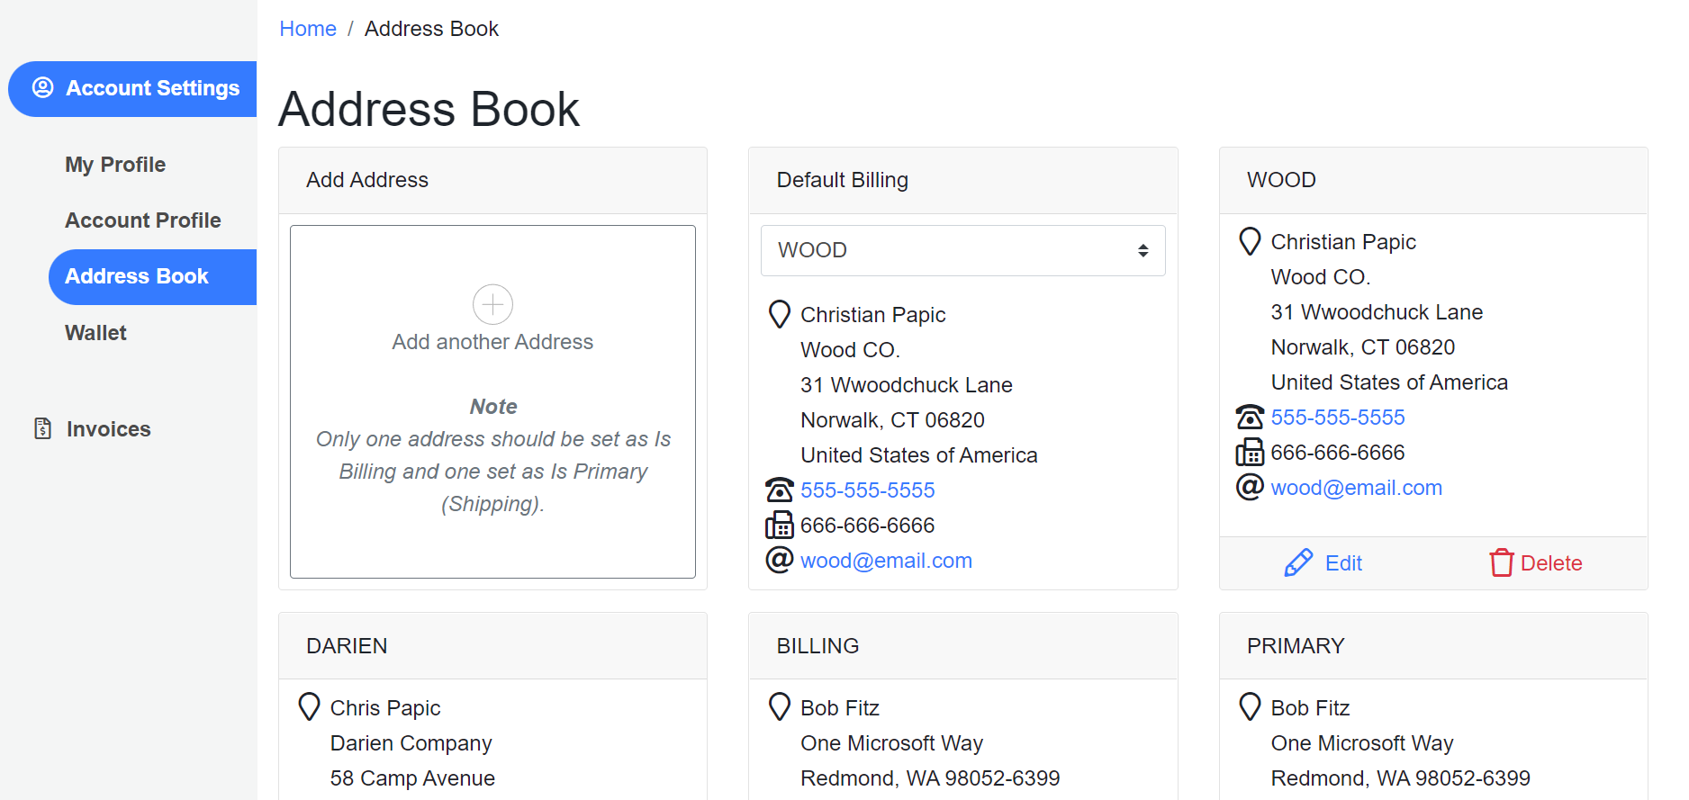
Address Book
Address Management for Billing Entries that can be selected at time of payment depending on which Credit Card is being used.

Slide 30
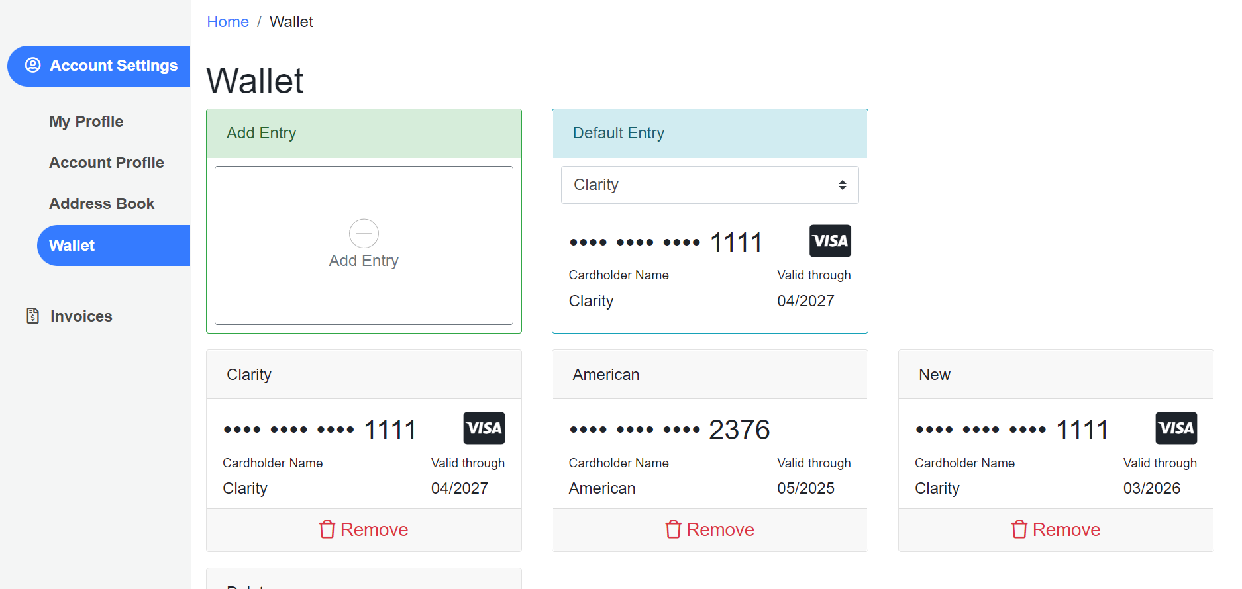
Wallet
A PCI Compliant Payment Module that allows the Customer to save Cards to their Account and then select from their saved payment methods when submitting payment.

Slide 31
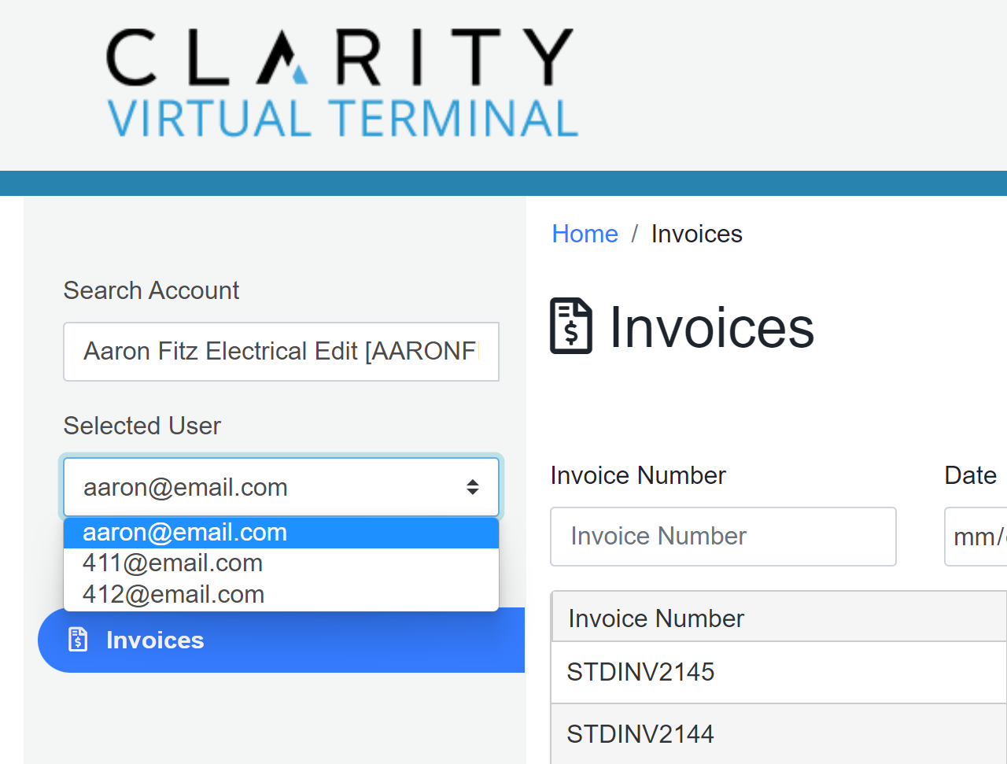
Virtual Terminal
The Virtual Terminal is a clone of the Customer Portal.
Includes a Customer Selector that only displays for Users with the CSR Role.
The CSR can utilize the Account Search Field and User Drop Down to select which Customer they are assisting.
The Virtual Terminal filters the data within the UI to show all Information associated with the User they select.
  Note: Virtual Terminal uses Account Associations to control which Customers show up within the Drop Down. The Virtual Terminal can control whether the CSR can see all or specific sub-sets of Customers

Slide 32
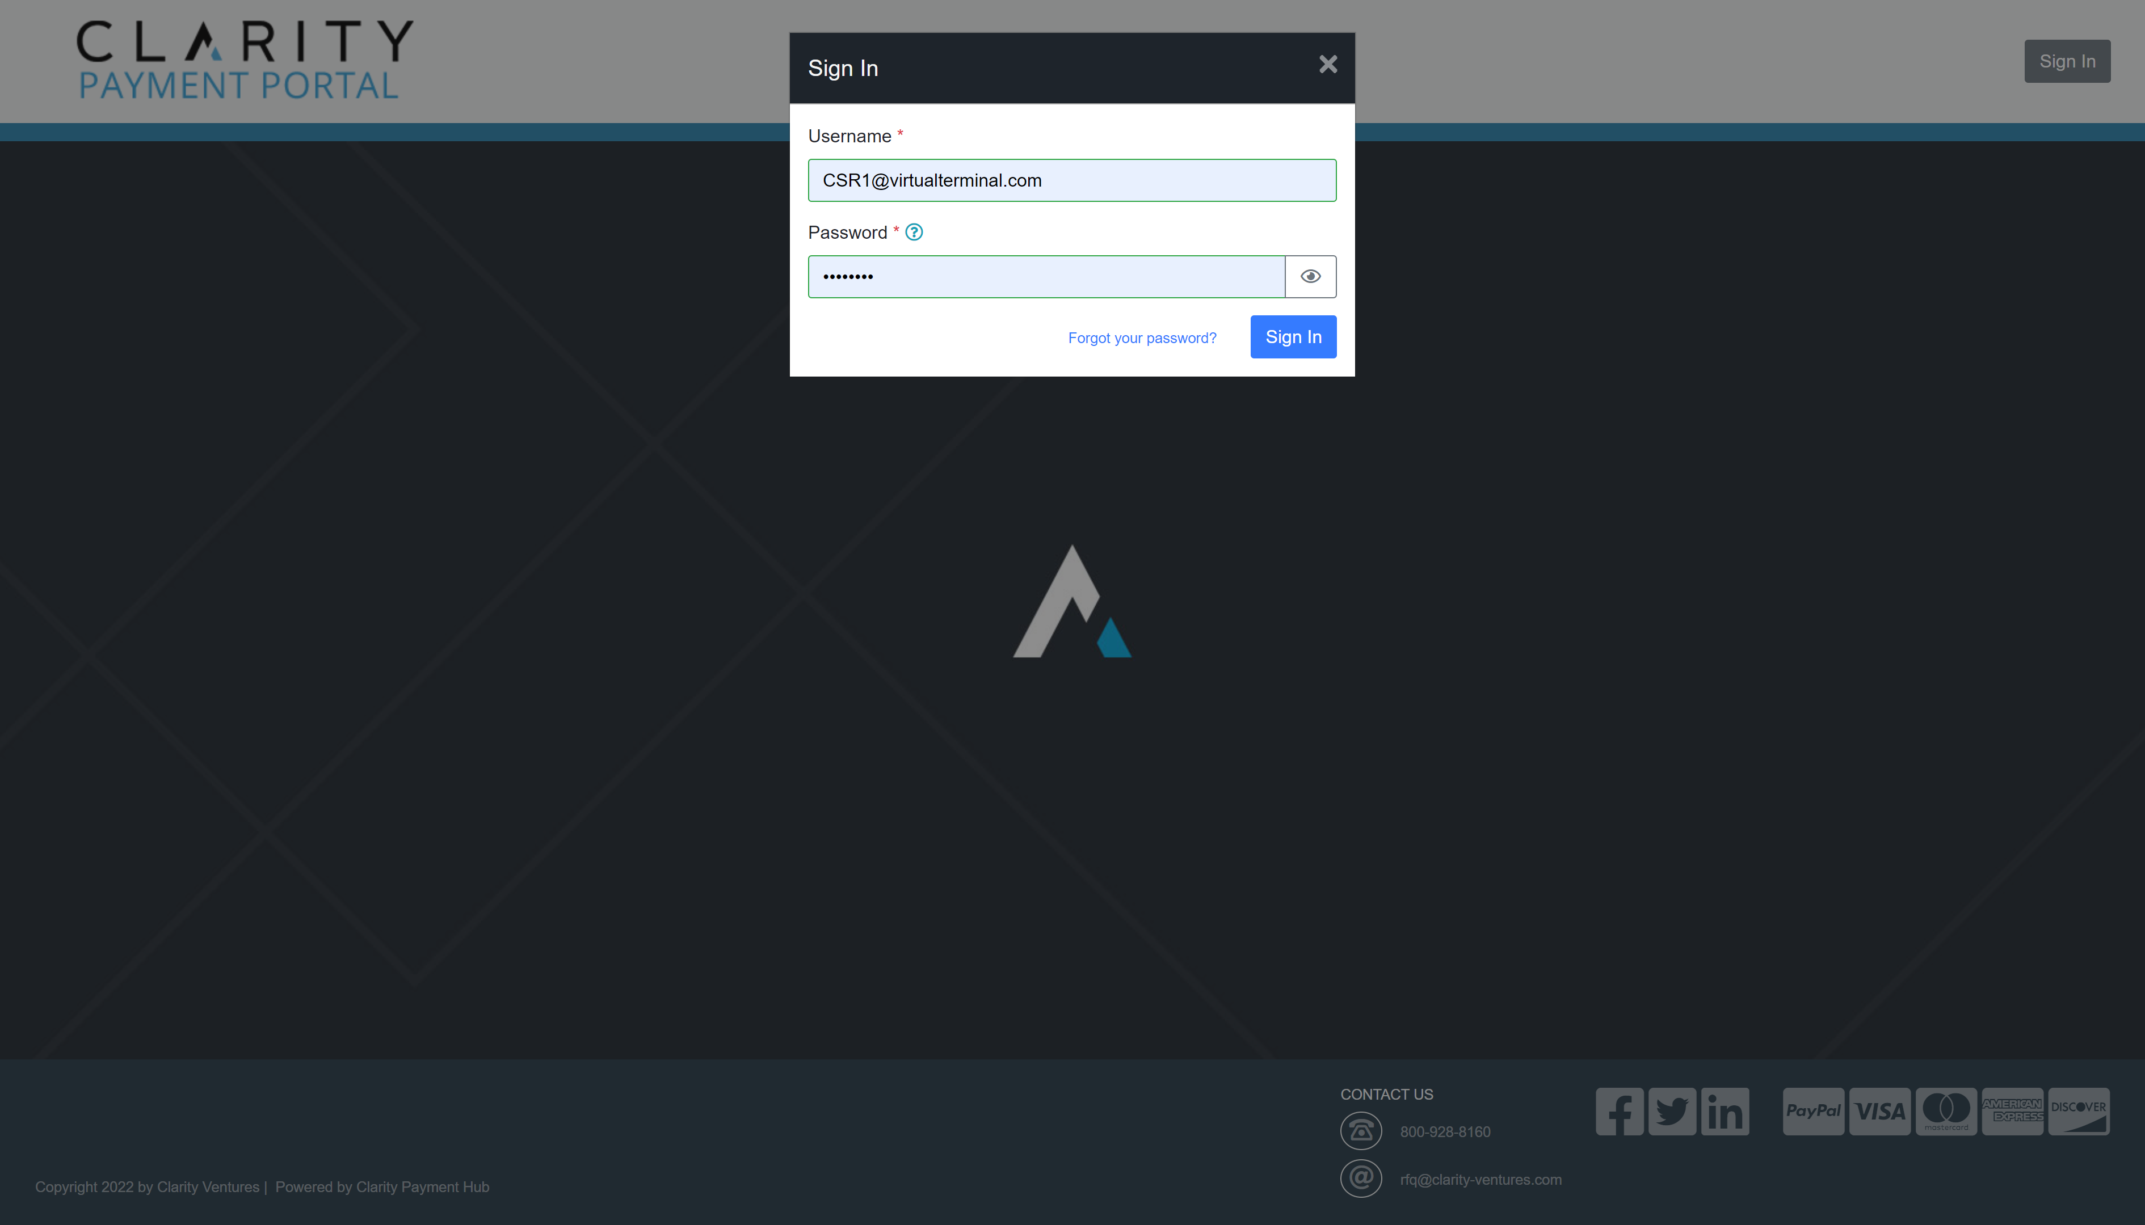

Slide 33
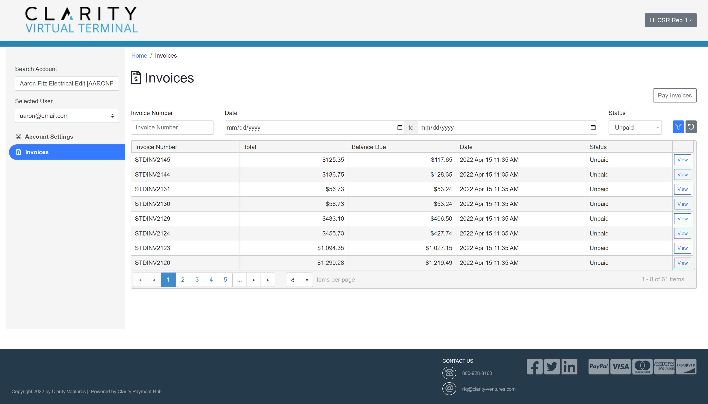

Slide 34
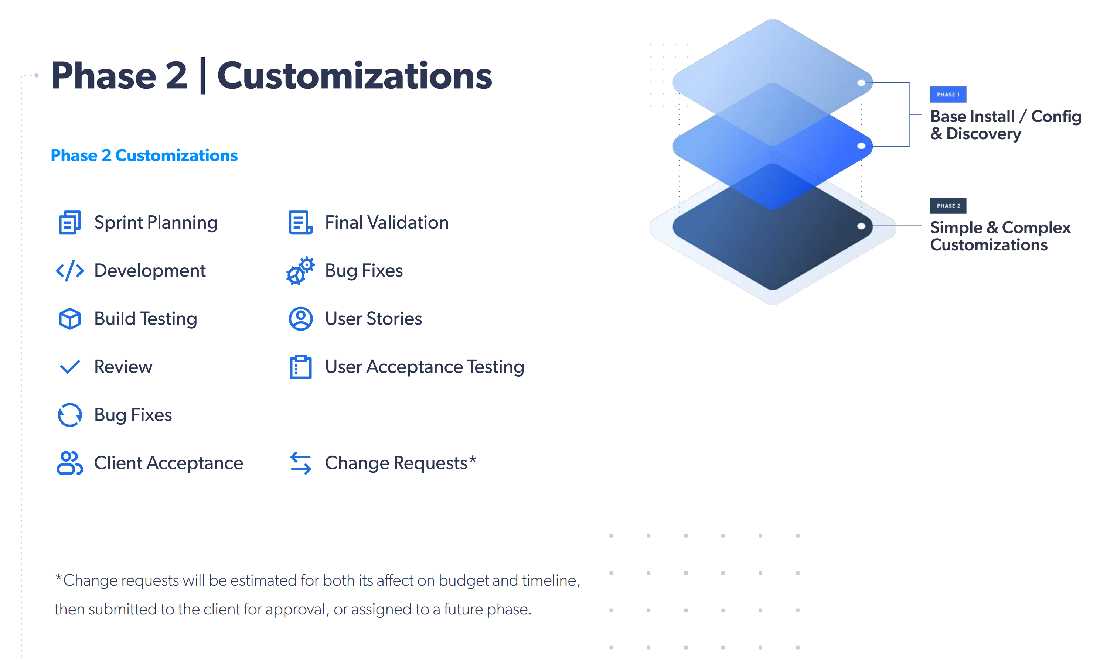
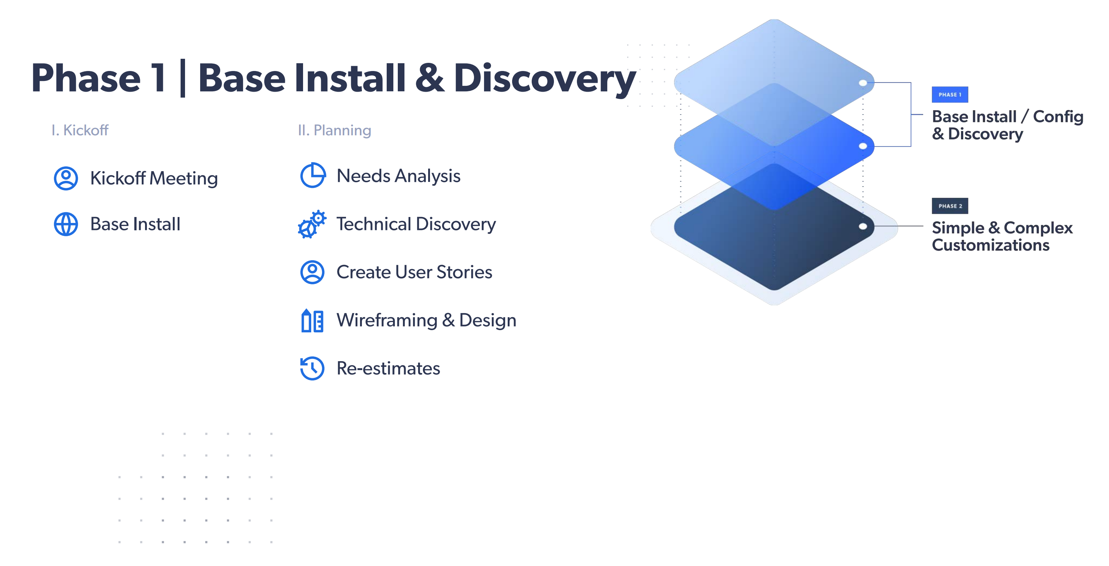


Slide 35
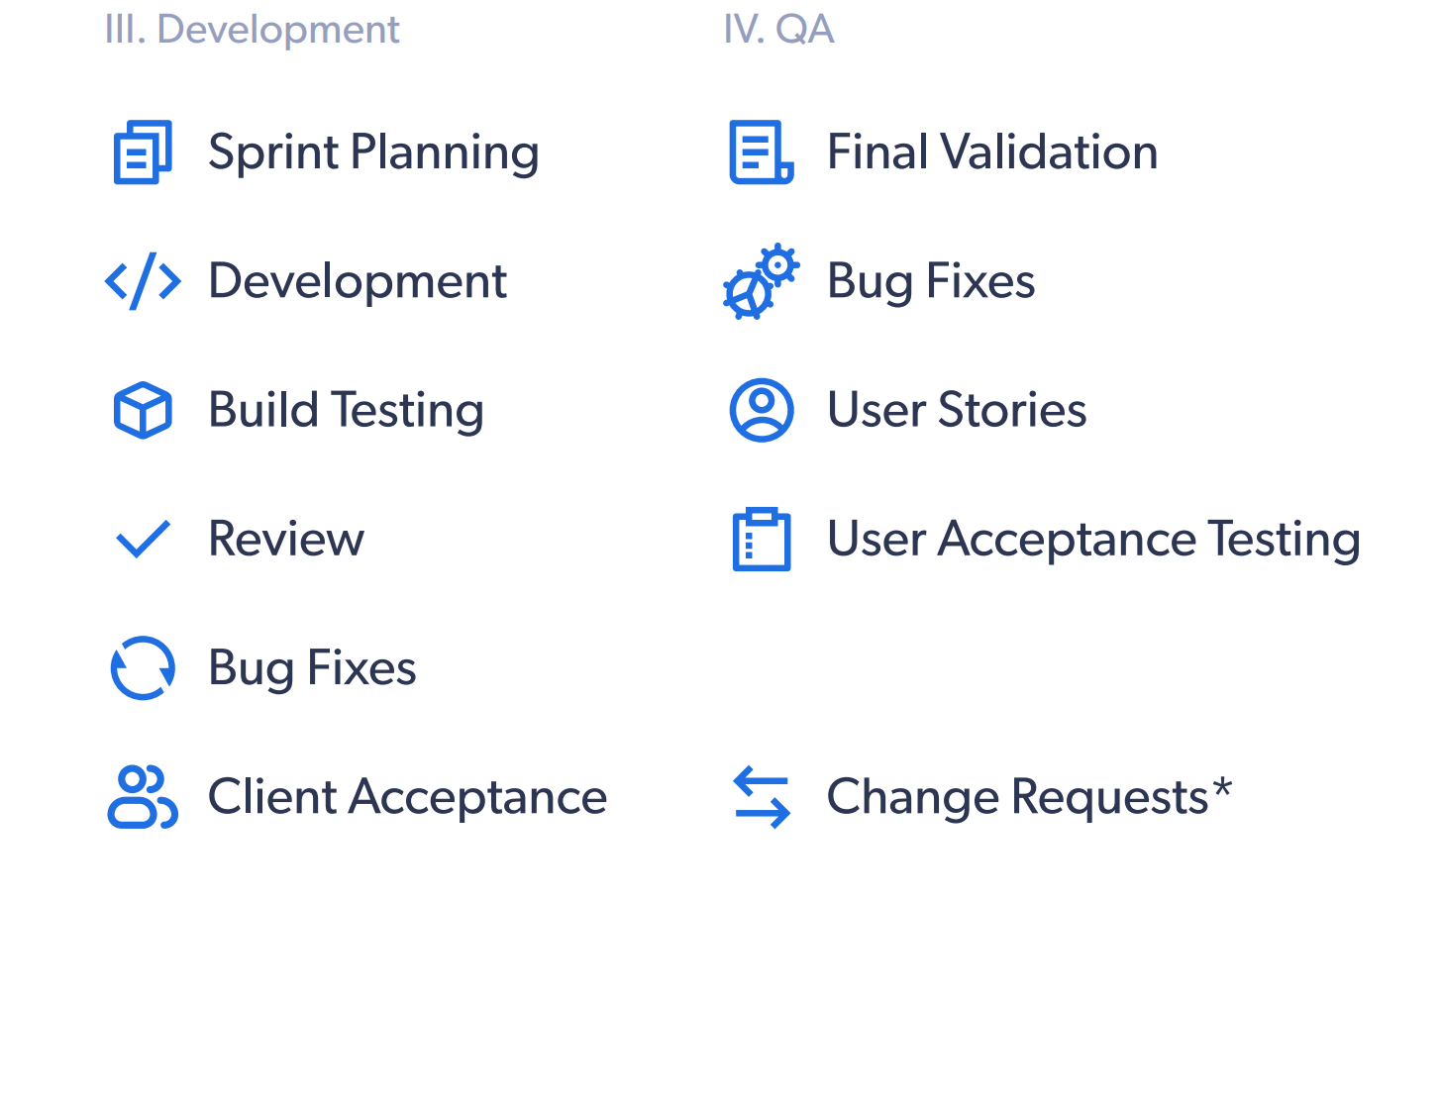
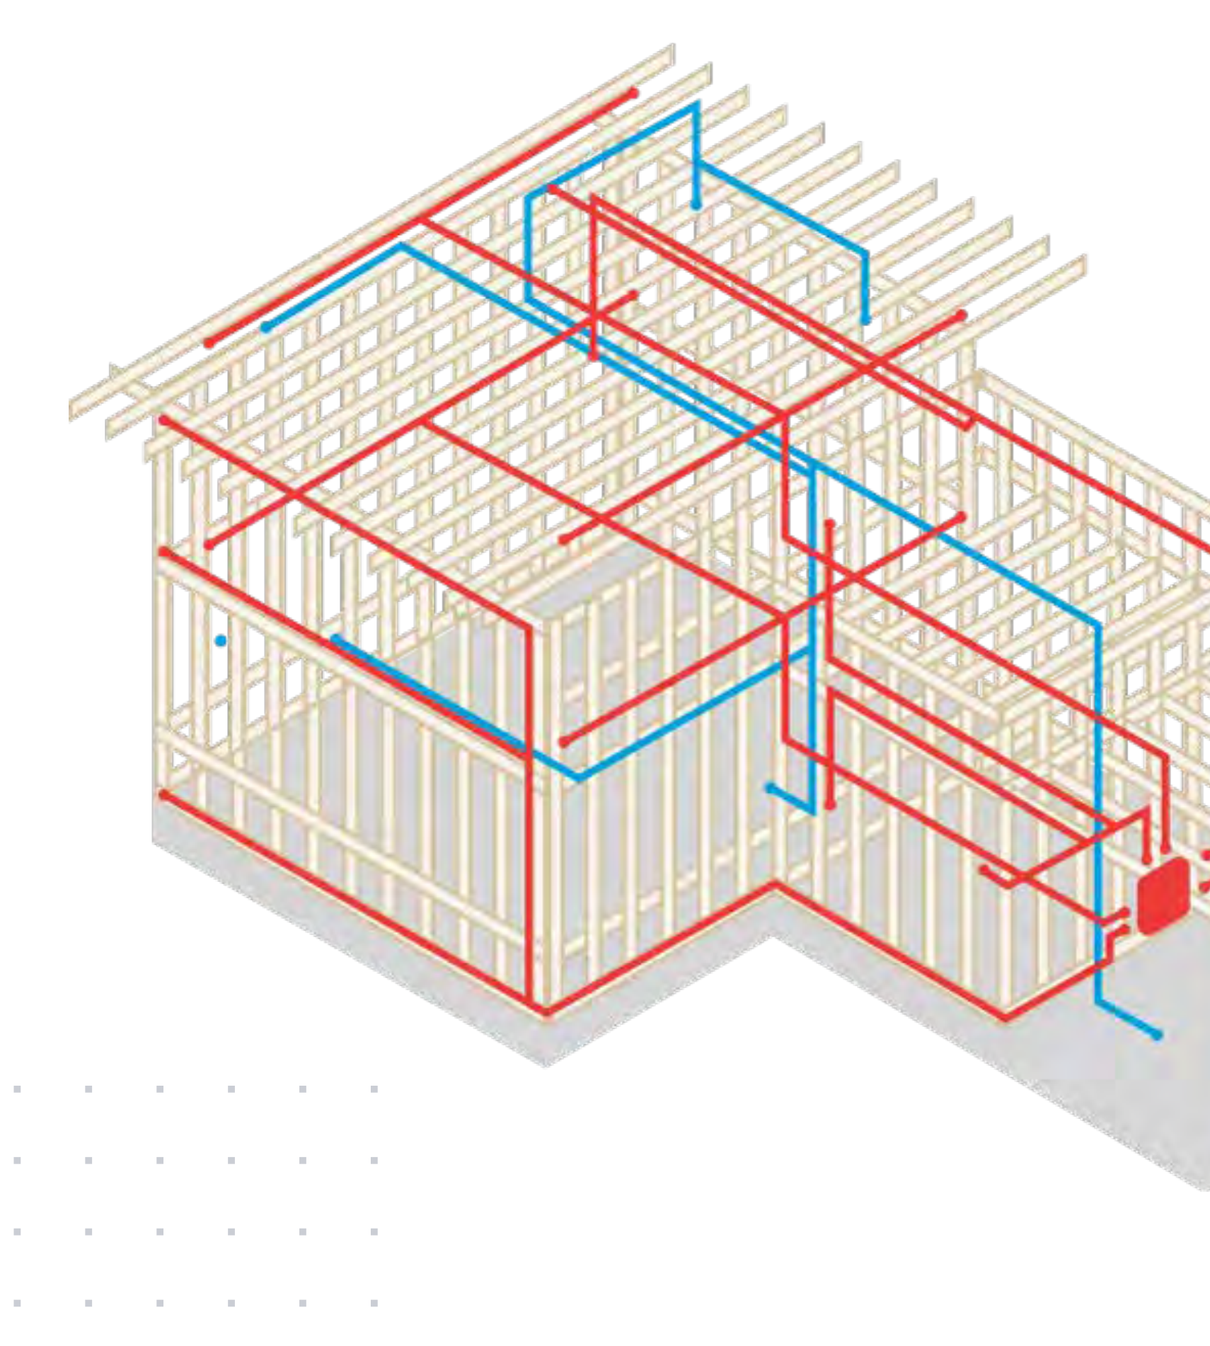

Slide 36
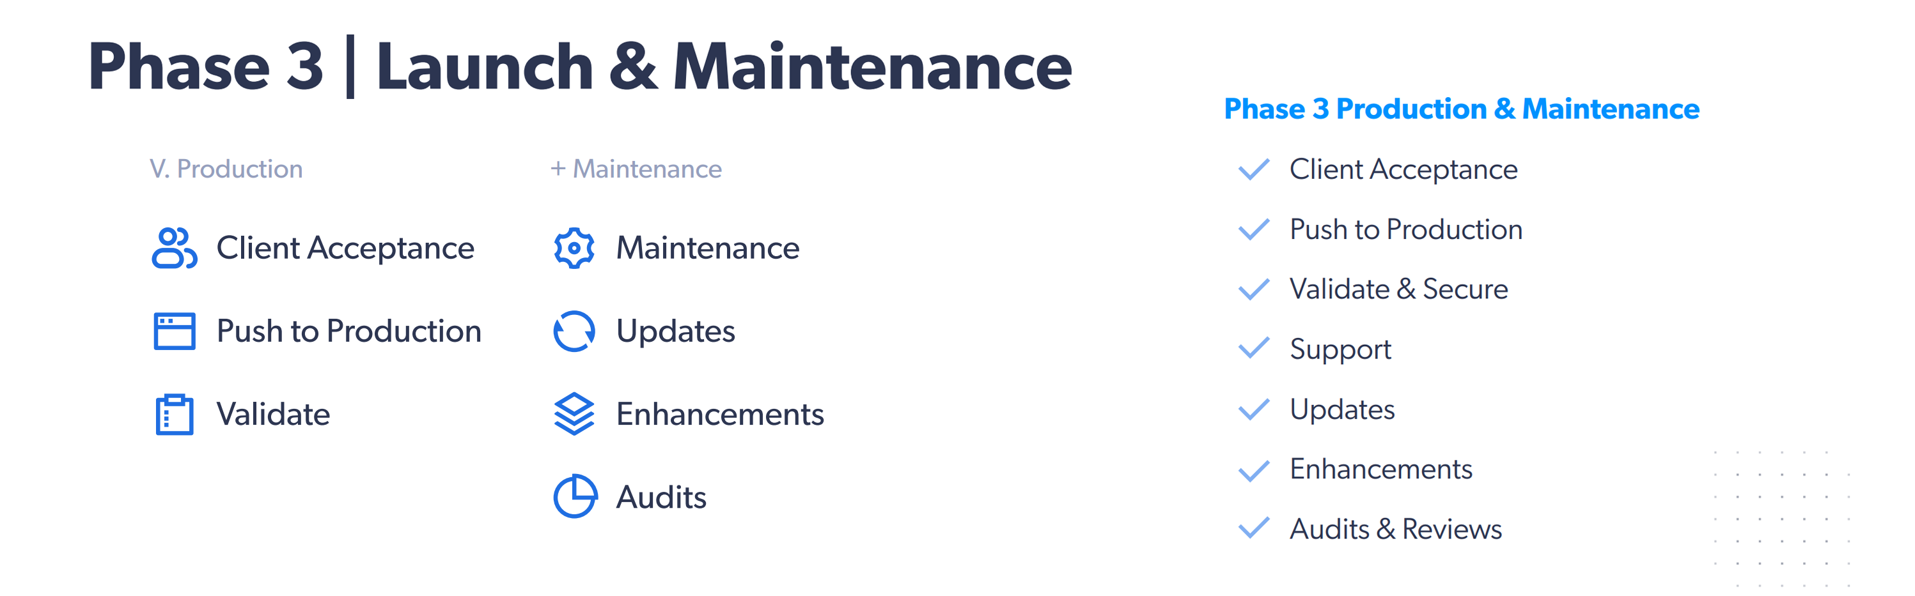
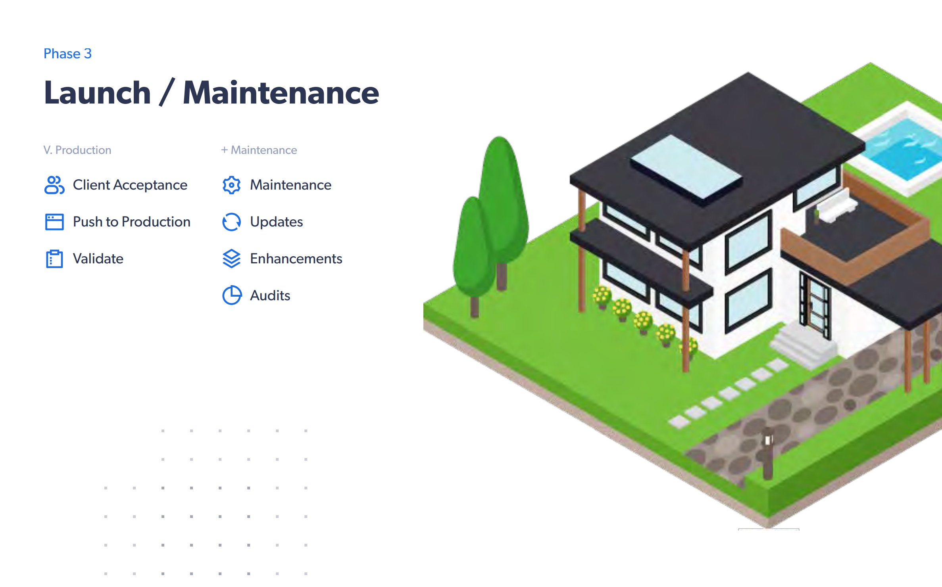

Slide 37




Pricing
License, Installation, and Configuration: $15,000
  Covers the Customer Portal, Virtual Terminal, & Integration Platform
  No ongoing license costs (one-time cost) and no throttling or limits on queries, numbers of records, etc.
Customizations (Optional)
  Variable depending on complexity
  Billed at the standard rates ($200/hr.)
OR - SaaS (Subscription): $599/month
  2-year Minimum Commitment
  Support Hours accrue at 1 hour per month
  Support Hours never expire.
Upgrades
  Upgrades are optional.
  Can be Subscription-Based (Monthly) or One-Time Purchases at a percentage of the total license cost. (pricing varies)

